Slide 1
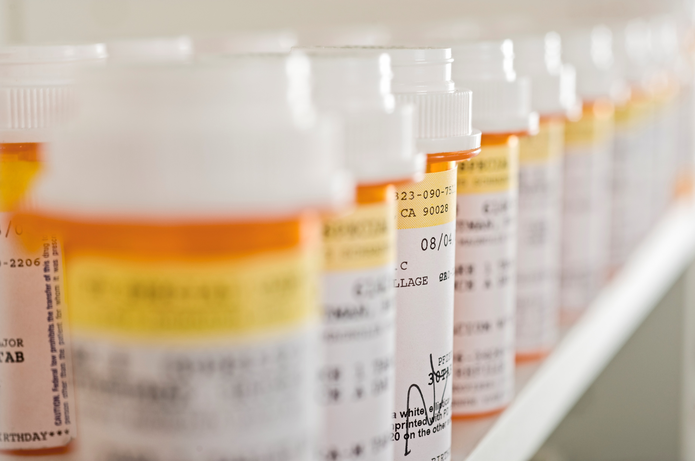
Prescription Assistance
New and Updated 10/29/25
How to access needed medications and save a few bucks!

Slide 2
Different types of assistance:
Insurance often determines what is available
  Government programs – check these first
  Manufacturer copay assistance – for employer-sponsored and exchange plans
  Manufacturer patient assistance programs – for uninsured (and often Medicare)
  Private copay assistance foundation grants – for Medicare and sometimes other kinds of insurance
  Discount cards and coupons – for uninsured and insured (can use instead of insurance)
  Discount online pharmacies – generally do not process insurance claims

Slide 3
Government Assistance:
Try this first – for Medicare patients
  Social Security Low-Income Subsidy (Extra Help)
    Income < 150% FPL with asset test
    www.socialsecurity.gov/extrahelp
  Medicare Savings Programs – run by the state – (No asset test!!!)
    Can cover Medicare B premiums and charges
    https://www.hca.wa.gov/free-or-low-cost-health-care/i-need-medical-dental-or-vision-care/medicare-savings-program
    This can be very helpful for individuals with assets over the LIS or Medicaid Classic limit

Slide 4
Government Assistance:
Medicaid
Medicaid “Classic” Aged, Blind, and Disabled
  Eligibility can be a “black box”, often has a “spenddown” to meet before benefits kick in
  Low asset limits
  Enroll with DSHS
Apple Health – NOT for Medicare Eligible
  There are currently 5 managed care plans and networks
  Eligibility is based on income only (no asset test)… limit is 138% FPL
  Enroll at the Washington Health Benefit Exchange

Slide 5
Manufacturer copay assistance
For employer-sponsored or exchange plans (Not for Medicare… Usually)
Normally, there is a nominal upfront out-of-pocket cost sharing
The assistance then covers up to a maximum amount per month or year
The patient is responsible for the remaining amount of the cost-sharing
Not means-tested
Try going to the medication’s website, i.e., www.Lantus.com or www.Spiriva.com
Only time this is available to Medicare patients is when pt also have employer-sponsored or retiree coverage and NO part D. Then SOME manufacturers MAY allow it

Slide 6
Manufacturer patient assistance programs:
For uninsured (and often Medicare)
  For brand-name medications that usually do not have low-cost generics
  Income-tested, 100% to 600%+ Federal Poverty Level depending on the program – no asset tests
  Enrollment is usually for 12 months
  Many will enroll Medicare D patients – enrollment through the end of the calendar year – some changes in medications/income requirements
  Some have additional eligibility requirements for Medicare patients – out-of-pocket requirement, ineligibility for LIS
  Very limited number of programs will help those with other kinds of insurance
  Information available at www.needymeds.org

Slide 7
Private copay assistance foundation grants:
For Medicare and sometimes other kinds of insurance
  Provides a limited amount of funds to be used to cover copays for medication that directly treats a covered condition
  Usually distributed as a pharmacy card billed secondary to insurance
  Funds availability is limited to periods when the disease fund is open for new grantees
  Means-tested – income limit 300% - 500% FPL adjusted for cost of living by zip code – some have waitlists and/or notifications to sign up for
  No Asset test
  www.fundfinder.org

Slide 8
Discount cards and coupons:
For uninsured and insured (can use instead of insurance)
  Must inform the pharmacist up front that you DO NOT WANT to use your insurance for the medication
  May be cheaper than the insured price
  Not all coupons can be used by individuals with Medicare, so check the coupon
  Best for generic medications; discounts are not that great with brand-name medications
  Try www.goodrx.com, www.singlecare.com (both have phone apps) and/or www.arrayrxcard.com

Slide 9
Discount pharmacies:
Generally, online discount pharmacies do not process insurance claims
  Try www.rxoutreach.org, www.costplusdrugs.com, and pharmacy.amazon.com
  Retail chain pharmacies (Walmart, Safeway, Fred Meyer, Target, Walgreens, etc.) often have low-cost generic formularies

Slide 10
Frequently Asked Questions
What about insulins?
  Insulins are available from 3 programs.
    Lilly Cares PAP – Humalog/Basaglar/Humulin N&R.
    Novo Nordisk PAP – Novolog/Levemir/Tresiba/
    Novolin N&R.
    Sanofi Patient Connections PAP – Lantus/Toujeo/Apidra.

Slide 11
Frequently Asked Questions
What about other diabetic medications
  Non-insulin injectables are available from:
    Novo Nordisk – GlucaGen, Xultophy (OZEMPIC is NOT available for Med D patients)
    Sanofi - Soliqua
  Oral medications are available from:
    Astra Zeneca – Farxiga, Xigduo XR
    Boehringer Ingelheim – Jardiance, Jentadueto, Synjardy
    Merck – Januvia, Janumet

Slide 12
Frequently Asked Questions
What about inhalers for Med D patients?
  AstraZeneca (Bevespi, Breztri) has no out-of-pocket requirement. Income cannot exceed 300% FPL.
  GSK (Anoro, Breo, Arunity, Serevent, Trelegy) has an out-of-pocket requirement of $600. Household income cannot exceed 300% FPL.
  Boehringer Ingelheim (Atrovent, Combivent, Spiriva, Stiolto, Striverdi) has no out-of-pocket requirement. The income limit is currently 200%fpl for inhalers.

Slide 13
Frequently Asked Questions
What about anticoagulants/antiplatelets?
  AstraZeneca (Brilinta) has no out-of-pocket requirement for Medicare patients. Income cannot exceed 300% FPL
  Bristol Meyer-Squibb (Eliquis) Income cannot exceed 300% FPL. Medicare patients have an out-of-pocket requirement of 3% of a patient’s gross annual income for Med D Patients.
  Johnson & Johnson (XARELTO) income limit is also 300% FPL and requires 4% out-of-pocket expenditure for Medicare patients

Slide 14
Frequently Asked Questions
Do all programs have financial eligibility requirements?
  Largely yes, but the requirements vary by program.
Do programs require citizenship?
  Many programs require citizenship or legal status. However, quite a few do not.

Slide 15
How to get assistance:
Eastern Washington
  Call Kelly Armstrong at 509-891-6420
  Email Kelly at kellya@prescriptiondrugassistance.org
  Fax Kelly at 888-342-6910
  Include contact information, kind of insurance, the medication that needs assistance, and basic income and household size information

Slide 16
How to get assistance:
Western Washington
  Call Rod Shutt at 206-518-0839
  Email Rod at rods@prescriptiondrugassistance.org
  Fax Rod at 866-501-4924
  Include contact information, kind of insurance, the medication that needs assistance, and basic income and household size information

