Slide 1
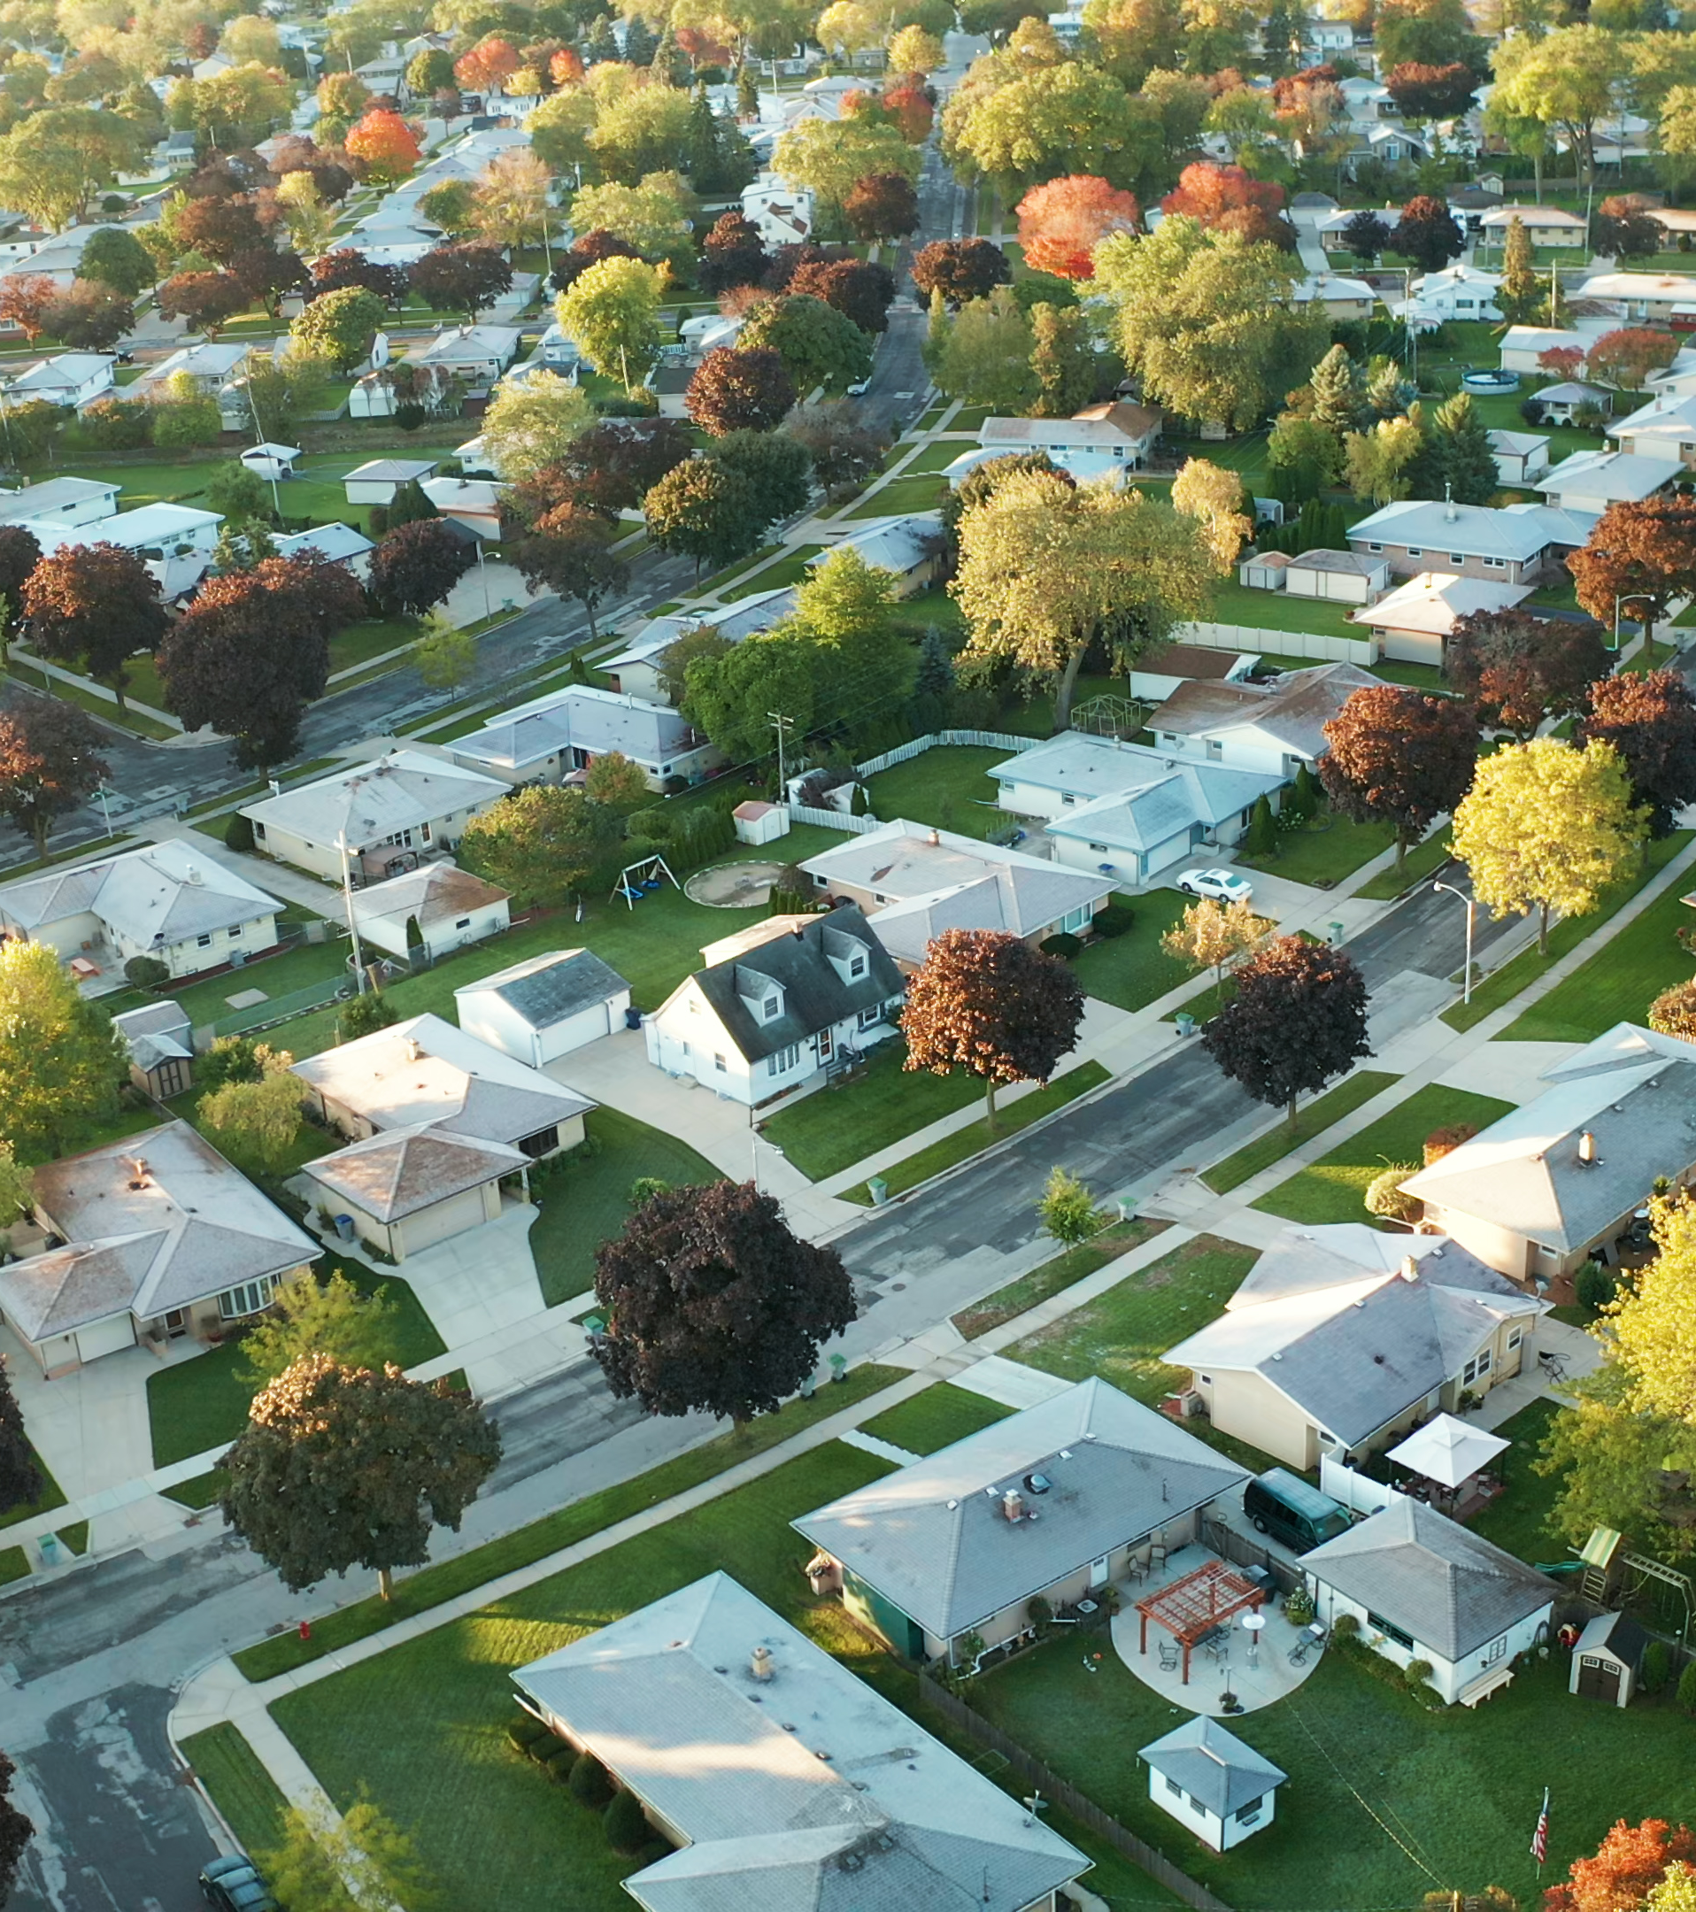
Wildland Fire Mitigation Standards AND guidelines
An Overview of Key Standards and Programs

Slide 2
Topics
01 | Introduction to the concept of mitigation standards and their benefits in reducing wildfire risks.
02 | Overview of the elements associated with mitigation standards.
03 | Leading standards, guidelines and models
04 | Description of the key components and focus areas of standards, such as defensible space, building construction, and risk reduction
05 | Information on certification programs and the requirements for certification

Slide 3
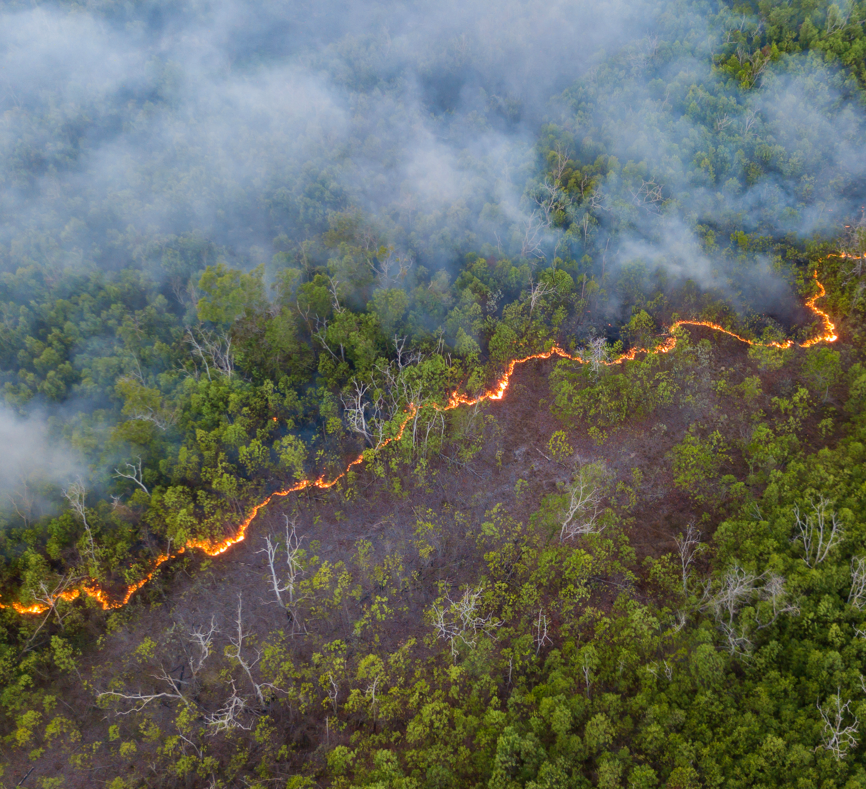
Why Mitigation Standards?
Wildfire mitigation standards are designed to reduce the risk and impact of wildfires on people, property, and ecosystems—especially in areas where the built environment meets wildland vegetation, commonly known as the wildland-urban interface or WUI.

Slide 4
Benefits of Mitigation Standards
Protect Life and Property
Minimize ignition risk: Standards guide the use of ignition-resistant materials and defensible space to prevent structures from catching fire.
Enhance survivability: Homes and infrastructure built to accepted standards are more likely to withstand wildfire exposure.
Promote Resilient Landscapes
Fuel management: Standards often include vegetation spacing, pruning, and fuel removal to reduce fire intensity.
Landscape-level planning: They encourage coordinated efforts across properties and jurisdictions to reduce overall wildfire risk.
Guide Risk Reduction Practices
Consistent best practices: They provide a framework for communities, developers, and land managers to follow proven mitigation strategies.
Informed decision-making: Standards are often based on risk assessments, fire behavior modeling, and lessons learned from past fires.
Strengthen Community and Individual Resilience
Break the disaster-rebuild-disaster cycle: Instead of rebuilding vulnerable structures, standards promote safer reconstruction.
Encourage long-term planning: They integrate wildfire risk into land use, zoning, and emergency preparedness plans.

Slide 5
COMMON ELEMENTS OF MITIGATION STANDARDS
Risk Assessment & Mapping
Post-Fire Hazard Mitigation
Defensible Space & Home Hardening
MITIGATION
Collaboration & Funding
Hazardous Fuel Reduction
Regulatory & Planning Tools
Education & Outreach

Slide 6
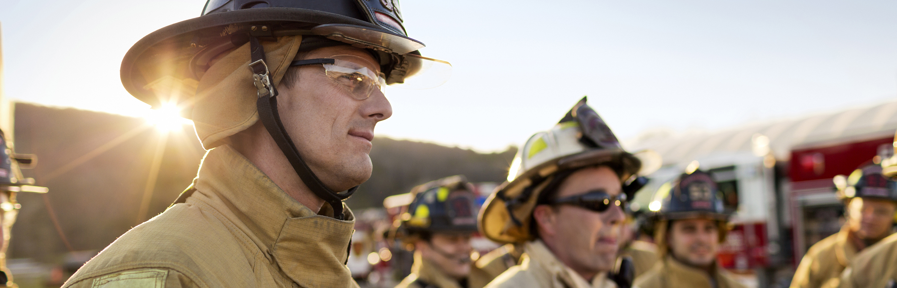
Where do Standards Come from?
Wildland fire mitigation standards come from the efforts of a diverse mix of national, state, and local organizations, and are shaped by research, policy evolution, and lessons learned from past wildfires.

Slide 7
Leading Standards and Guidelines

Slide 8
Wildfire Prepared Home
Managing Organization: Institute for Business & Home Safety (IBHS) Wildfire Prepared Home, a Program of IBHS - Resources
Scope: California and Oregon (currently)
Key Components and Focus:
  Wildfire Prepared Home™ is a designation program designed to reduce wildfire risks through a set of mitigation actions at the parcel level.
  The program offers two levels of protection to choose from, Base or Plus. Homeowners must meet and maintain the requirements for their selected level to earn a designation certificate.
Certification: Yes (designation only)
Intended Users: Homeowners, insurers, builders
Base-level:
• Creating the 0–5 Foot Noncombustible Zone
Maintaining 30 feet of defensible space
Upgrading vulnerable building features
Plus-level:
Provides stronger protection against radiant heat and direct flame contact by adding enhanced building features and stricter defensible space requirements within the first 30 feet of the home.

Slide 9
Firewise USA®
Organization: National Fire Protection Association® (NFPA®) NFPA | Firewise USA®
Scope: National
Key Components and Focus:
  Community assessments, wildfire mitigation plans, recognition process
Certification: Yes (community certification)
  Create and implement a local plan with cooperative assistance from state forestry agencies and local fire staff.
  Continue regular maintenance and education to retain recognition status.
  Meet specific voluntary criteria, plus any additional state-required criteria, on an annual basis.
  Work together in a community to reduce wildfire risk through education and collaboration.

Slide 10
Wildfire Ready Neighbors
Organization: Department of Natural Resources Home | Wildfire Ready Neighbors!
Scope: State of Washington
Key Components and Focus:
  Provides a free Wildfire Ready Plan to help prioritize wildfire ready actions on property and connects homeowners with local wildfire mitigation experts in their area.
  Voluntary home assessments focusing on three zones; immediate, intermediate and extended. Up to 200’ feet from structures.
Certification Program: No
Intended Users: WA residents, DNR Outreach Teams, Fire Service

Slide 11
International Wildland-Urban Interface Code
Organization: International Code Counsel (ICC) https://www.iccsafe.org/products-and-services/wildland-urban-interface-code/
Scope: National
Key Components and Focus:
  Regulates ignition-resistant construction techniques and defensible space as well as fire department access and available water supplies for fire suppression.
  Focuses on preventing ignition of buildings and vegetative fuels from direct exposure to wildfire and fire exposure from adjacent structures.
  Helps prevent structure fires in the WUI from spreading to wildland fuels, even in the absence of fire department intervention.
Certification: No
Intended Users: Builders, Zoning Boards, Code Officials, Homeowners

Slide 12
Hazard Mitigation Methodology (HMM)
Organization: National Institute of Standards and Technology (NIST) Hazard Mitigation Methodology - NIST
Scope: National
Key Components and Focus:
  Designed to be applied in communities located in hazardous fire prone WUI areas.
  The goal of the HMM is to reduce the overall implementation burden by assessing local exposures and applying the latest laboratory research findings and knowledge from post-fire field observations to effectively harden structures in a cost-effective way.
  The HMM is primarily aimed at retrofitting existing buildings but may be applied to new construction.
Certification: No
Intended Users: Authorities with jurisdiction and homeowners.

Slide 13
NFPA 1140 Standard for Wildland Fire Protection
Organization: National Fire Protection Association® (NFPA®) Using Standards to Protect Homes from Wildfires | NFPA
Scope: National
Key Components and Focus:
  Addresses risk reduction for existing and new development, as well as the operational needs of wildland firefighting.
  Includes guidelines for maintaining defensible space around structures to minimize fire spread.
  Sets standards for ignition-resistant construction in fire-prone areas.
Certification: No
Intended Users: Homeowners, Zoning Boards, Building Officials and Fire Service

Slide 14
Outthink Wildfire
Organization: National Fire Protection Association® (NFPA®) http://www.nfpa.org/outthinkwildfire
Scope: National
Key Components and Focus:
Calls for a comprehensive approach that, over time, attempts to significantly reduce risk to communities. The strategy is rooted in two perceived realities—wildfires are going to happen, and the fire service will not be able to extinguish these fires at a pace to save people and property in their path. There are five action policies associated with Outthink Wildfire:
  Require all homes and business in the wildland-urban interface (WUI) to be more resistant to ignition from wildfire embers and flames.
  Current codes and standards, as well as sound land-use practices, must be in use and enforced for new development and rebuilding in wildfire-prone areas.
  Fire departments for communities in the WUI must be prepared to respond safely and effectively to wildfire.
  Government must increase resources for vegetative fuel management on public land.
  Members of the public must understand their role and take action in reducing wildfire risk.
Certification: No
Intended Users: Homeowners, Zoning Boards, Building Officials and Fire Service

Slide 15
NWCG Wildland Urban Interface Mitigation Field Guide, PMS 052
Organization: National Wildfire Coordinating Group (NWCG) NWCG Standards for Mitigation in the Wildland Urban Interface PMS 052
Scope: National
Key Components and Focus:
  Designed to support common understanding.
  Encourage use of consistent and proven local risk reduction efforts.
  Increase awareness and implementation of mitigation best practices, techniques, tactics, and strategies.
  Improve community and structure survivability as the result of pre-wildfire mitigation actions.
Certification: No
Intended Users: Wildfire Mitigation Practitioners, Fire Service and Homeowners

Slide 16
NWCG Wildland Urban Interface Mitigation Field Guide, PMS 053
Organization: National Wildfire Coordinating Group (NWCG) NWCG Wildland Urban Interface Mitigation Field Guide, PMS 053 | NWCG
Scope: National
Key Components and Focus:
  Provides mitigation practitioners at all experience levels with recommendations on the most effective and efficient ways to accomplish mitigation work in communities at risk to wildfire damage or destruction.
  Written in coordination with the NWCG Standards for Mitigation in the Wildland Urban Interface, PMS 052, and is intended to act as an in-depth supplement to that
  Publication
Certification: No
Intended Users: Wildfire Mitigation Practitioners, Fire Service and Homeowners

Slide 17
California Wildfire Mitigation Program
Managing Organization: Cal OES & CAL FIRE California Wildfire Mitigation Program | California Governor's Office of Emergency Services
Scope: State of California
Key Components and Focus:
  Provides financial assistance to support wildfire home hardening for homeowners who qualify for the program. Wildfire home hardening includes retrofitting homes with ignition-resistant materials and creation of defensible space.
  Community and homeowner education on wildfire home hardening.
  A framework that can be modeled throughout California communities.
Certification: No
Intended Users: Homeowners, Builders, Fire Service and Mitigation Practitioners

Slide 18
FLAMES (Fire Loss and Mitigation Evaluation Score)
Managing Organization: American Association of Insurance Services (AAIS) White-Paper-FLAMES.pdf
Scope: National*
Key Components and Focus:
  Is a data driven, predictive model developed to help insurers more accurately quantify expected fire severity at the ZIP code level.
  Provides for evaluation of homes, landscapes, and community mitigation measures
Certification: No
Intended Users: Insurers and Regulators
* Only approved for use in Florida

