Slide 1
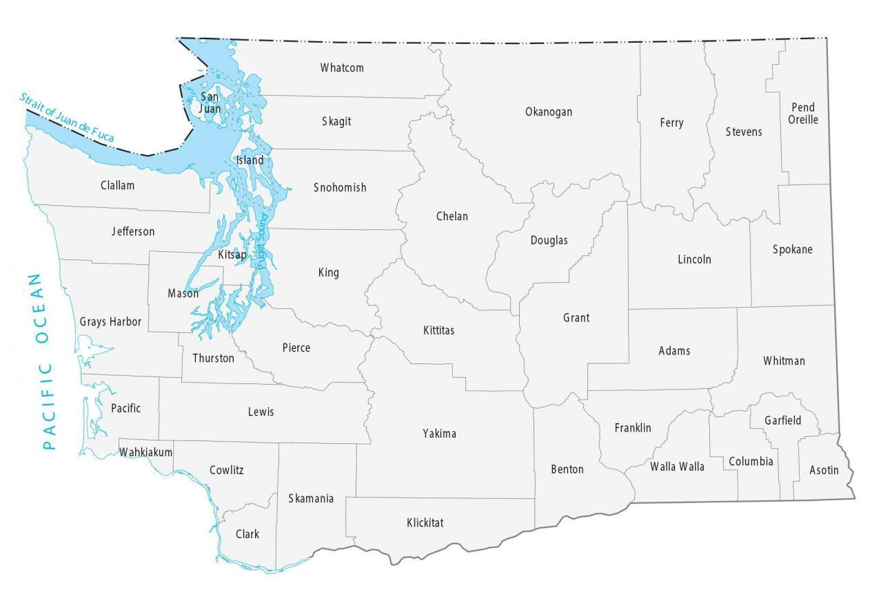
RTC Territory Map Updated April 2025
Whatcom
Lynda Dieckman
(all shades of green)
Office: 360-725-7257
Cell: 360-742-4949
Lynda.Dieckman@oic.wa.gov
Okanogan
Pend Oreille
Skagit
Ferry
Stevens
Shannon Skye
(all shades of blue)
Office: 360-725-7108
Cell: 360-250-4900
Shannon.Skye-Dugovich@oic.wa.gov
Clallam
Snohomish
Chelan
Jefferson
Douglas
Kitsap
Lincoln
Spokane
Coming Soon!
(purple)
Office:
Cell:
@oic.wa.gov
King
Mason
Grays Harbor
Kittitas
Grant
Pierce
Adams
Whitman
Rosie Rodriguez-Lee
(red)
Office: 360-725-7253
Cell: 360-701-0933
Rosie.Lee@oic.wa.gov
Thurston
Pacific
Lewis
Franklin
Garfield
Yakima
Noreen Brisson
(all shades of orange)
Office: 509-568-3043
Cell: 360-349-2850
Lynda.Dieckman@oic.wa.gov
Wahkiakum
Columbia
Cowlitz
Benton
Walla Walla
Asotin
Skamania
Clark
Klickitat
Coming Soon!
(all shades of yellow)
Office:
Cell:
@oic.wa.gov
New Sponsor contract – April 1, 2025
New Sponsor contracts – July 1, 2025

Slide 2
Sponsor Organization Key
Olympic Area Agency on Aging (O3A) Counties: Clallam, Grays Harbor, Jefferson, Pacific
Senior Services of South Sound (SSSS) Counties: Mason & Thurston
Area Agency on Aging and Disabilities of Southwest WA (AAADSW) Counties: Wahkiakum, Cowlitz, Clark, Skamania, & Klickitat
Timber River Connections (TRC) County: Lewis
Island Senior Resources (ISR) Counties: Island, Clinton, Coupeville, Langley, Oak Harbor, & Whidbey Island
Orcas Senior Center (OSC) Counties: San Juan, Friday Harbor, Lopez Island, & Orcas Island
Whatcom Council on Aging County: Whatcom
Edmonds Waterfront Center (EWC) Counties: Skagit & Snohomish
Peninsula Community Health Services (PCHS) County: Kitsap
Sound Outreach County: Pierce
Chinese Information Services Center (CISC) County: King
Solid Ground County: King
Action Health Partners (AHP) Counties: Okanogan, Chelan, Douglas, Grant, & ` Adams
Rural Resources Counties: Ferry, Stevens, Pend Oreille, & Lincoln
Aging & Long-Term Care of Eastern WA (ALTCEW) Counties: Spokane & Whitman
WA-ID Volunteer Center (WIVC) Counties: Garfield & Asotin
Kittitas County Health Network (KHCN) County: Kittitas
Retired & Senior Volunteer Program (RSVP) Counties: Yakima
Catholic Charities Serving Central WA (CCSCW) Counties: Benton, Franklin, Walla Walla, & Columbia

