Slide 1
Work Group- insurance hard market update

Slide 2
How insurance works
Spreading (or pooling) of risk is the central concept of the business of insurance.
If risks (chance of loss) can be divided among many members of a group, the financial cost to recover is spread out to many.
A pool with more low-risk individuals will result in lower premiums, a pool of high-risk individuals will have higher premiums.

Slide 3
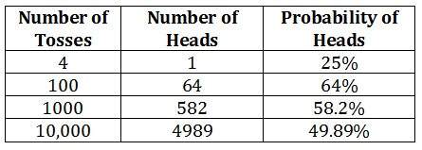
How insurance is stable
The Law of Large Numbers holds that, as a sample of observations increases in size, the relative variation around the mean declines.
In insurance, with a large number of policyholders, the actual loss per event will equal the expected loss per event.

Slide 4
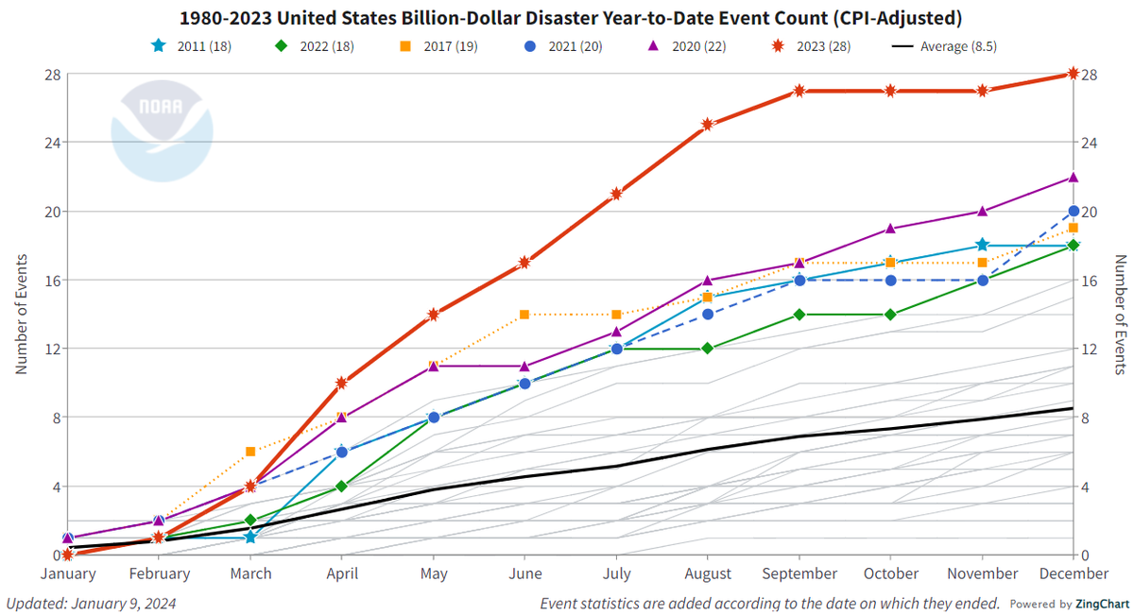
How property insurance is changing

Slide 5
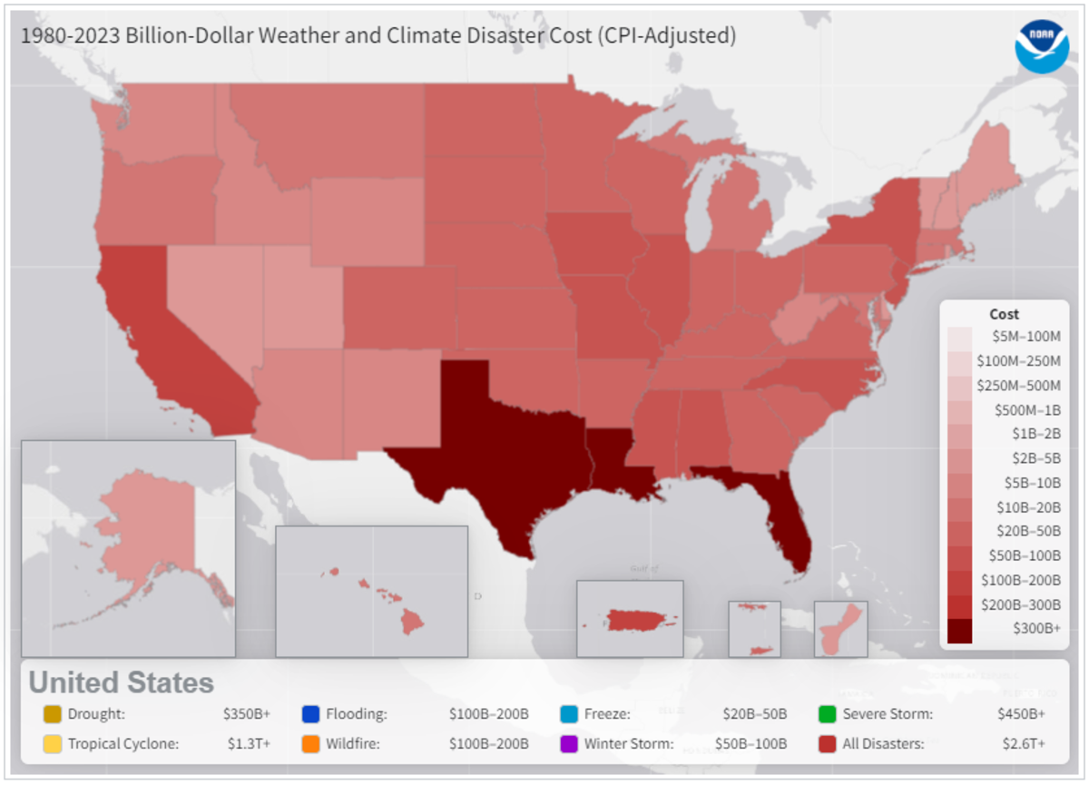
How property insurance is changing

Slide 6
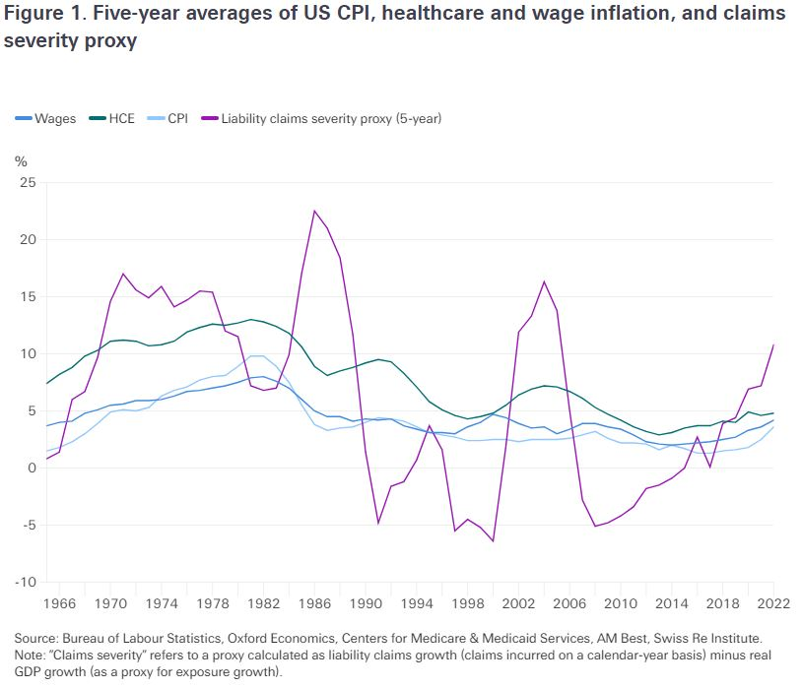
How liability insurance is changing

Slide 7
How liability insurance is changing
The current rate of liability claims inflation (16%) is unsustainable.
Increase in medical costs
Increase in jury verdict amounts.
  Trust in institutions declining- corporations should be held accountable via jury verdicts- Punitive damages increased by 20%.
Advent of litigation finance business model.
Investment returns due to higher interest rates will not be enough to cover the cost of claims, and liability insurers will need to retain focus on underwriting discipline.

Slide 8
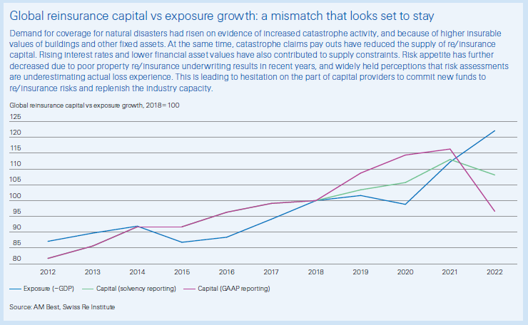
How reinsurance is changing

Slide 9
How commercial insurance is changing
WA Commercial* claim costs:
  2018: $1,022,356,000
  2019: $1,088,664,000
  2020: $1,149,609,000
  2021: $1,316,646,000
  2022: $1,418,556,000
  2023: $1,683,752,000 (65% increase from 2018)
  * Not including commercial auto or medical professional liability claims

Slide 10
How P&C insurance is changing
Global and National market pressures:
Natural Disasters and Climate Change
Economic Factors
Litigation Trends
Emerging risks
Lack of capacity and market dynamics
What can we control in WA?
Actual risk and perception of risk = insurability
Cost of claims = affordability

Slide 11
Work Group- OIC regulatory framework

Slide 12
WA state Insurance Commissioner
A state-wide elected official
The legislature created the office in 1889 and became its own agency in 1907
The Commissioner’s authority comes from the Legislature in Title 48 RCW.
“We protect consumers, the public interest and our state’s economy through fair and efficient regulation of the insurance industry.”

Slide 13
Office of the Insurance Commissioner
Types of P&C companies we regulate
Authorized companies (RCW 48.05)
  Licensed (750 P&C companies and another 200 liability only)
  Insurance producers (agent/brokers)
    ~74k producers
  Review and approve policy forms and rates
    ~3200 policy filings and 3000 rate filings per year
Unauthorized companies (RCW 48.15)
  Unlicensed- About 14% of the market
  Do NOT review and approve policy forms and rates
  Surplus line brokers
    ~4.3k licensed brokers
Risk Retention Groups (RCW 48.92) (liability only)
  Created by the federal govt., file a notice with OIC when doing business in WA.
  OIC cannot reject a notice from an RRG.
  Do NOT review and approve policy forms and rates

Slide 14
Questions?
David Forte
Senior Policy Advisor, Property & Casualty
david.forte@oic.wa.gov / 360-725-7268
Connect with us!
Facebook: https://www.facebook.com/WSOIC
Twitter: https://twitter.com/WA_OIC
www.insurance.wa.gov

