Slide 1
You & Medicare
December 2023
Notes:
Good Morning. Welcome to our program about You & Medicare. My name is Tim Smolen. I am your presenter for today. I am the Program Manager for the SHIBA program. which is a free service of the Washington State Office of insurance Commissioner. I am very grateful to our colleagues at DRS for the invitation today. This program will be about an hour long, including time at the end for questions and answers.

Slide 2
SHIBA Program Manager
  Tim Smolen
  SHIBA Program Manager
  360.725.7091
  tim.smolen@oic.wa.gov
Notes:
Thank you for inviting us today. I am saying “us” to acknowledge that the substantial work of the program is completed by our network of trained volunteers and Volunteer Coordinators as well as community partners and the professional staff with whom I work at the OIC.
Today's program will be recorded. It'll be available on the DRS website as well as the slide deck that accompanies this program.

Slide 3
Agenda
Guided tour of Medicare
  Eligibility
  Enrollment
  Approaches to benefits
  Premium costs
  Covered benefits
SHIBA program
Question & Answer time
Notes:
Here’s what we're hoping to accomplish today.

Slide 4
Do you know us?
Q1 / Heard of SHIBA?
Q2 / Worked with a SHIBA volunteer?
Notes:
OK, using the Q&A feature – these are yes / no questions –
How well do you know us?

Slide 5
This program is for…
You – the beneficiary
You – the advocate helping somebody
You – being curious and a good citizen
Notes:
The principal audience I have in mind is a person who is approaching Medicare eligibility and enrollment
It will be important to help people that are enrolled already as well
We are so grateful to people that are helping other people
And we can’t overstate the importance of more people knowing more about Medicare for a host of reasons

Slide 6
Medicare
Aged / Disabled
Citizen / Legal Permanent Resident
Working / Not working / Retired
Other insurance, in addition to Medicare?
Original Medicare / Medicare Advantage
Lower income / Mid-range income / Higher income
Rural / Suburban / Urban
Technology literate / Digital divide
English / ESL
Notes:
Medicare is a very diverse program and how you experience Medicare is a lot about your own self as a human being and also your own person as a beneficiary or a consumer of insurance.
There is essentially you as a human being, and then you have certain “features”, as it relates to the Medicare system. everyone encounters that system very differently.

Slide 7
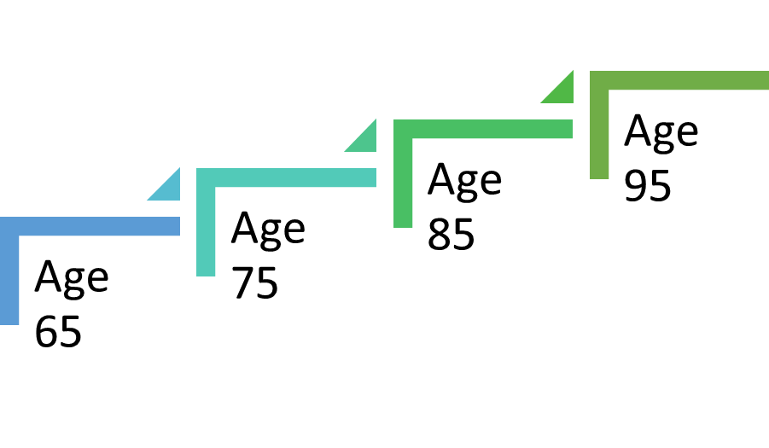
You are changing – your needs will change
Notes:
How you relate to the system changes over time.
For a person who is, say, 65 years old and starting in Medicare. I’m convinced that your needs will change and over the course of the time that you are alive and enrolled in Medicare, which for a lot of people is going to be many years.
You can imagine yourself starting at 65, becoming 75, becoming 85, becoming 95 years old. the forecast for us as human beings are that many of us are living quite a lot longer. So, we will be living in retirement and with Medicare potentially for decades. you can imagine that your needs will change over time.
Of course, you can imagine the Medicare program itself will change over time. So, this would be my first important point for today.

Slide 8
Objectives
Medicare really requires your active engagement
  The Medicare system is not going to take care of you
Have an effective engagement
  Stay informed about your rights, options, and protections
  Seek out expert and caring help – for technical ‘stuff’ and emotional support, too
Notes:
If there was a small number of takeaways from today's program. the first one would be that the Medicare program really requires your active engagement.
Medicare for us, for you, is a full contact support. You cannot be passive. Inside of this arrangement, the Medicare system is not going to take care of you. In that way it requires your active engagement. The corollary to that is the SHIBA program is here to help.

Slide 9
Eligibility and enrollment

Slide 10
Scenario #1
Paul is 64 years old. He’ll be 65 in a few months time. He works for Washington State government, in a professional role. He’s married. He’s eligible for social security now, but wants to wait to enroll, so he can get a larger monthly payment. Because he likes his job and can still continue working, he's going to do that. He might work until age 67. That’s 20 years and full social security benefit – he reasons.
Notes:
We're imagining today's program as if you're encountering the Medicare program for the first time. In effect, you're coming into eligibility.
The first part of today's program is going to be about eligibility. Who is eligible?
I’m going to refer to Medicare as an entitlement program. And so, I'm going to talk about who's entitled to the program. And how do they exercise or use their entitlement. So, who's entitled? And how do they get started?

Slide 11
Eligible by reason of age
This is the reality that most people conjure when they think about Medicare: it’s insurance for older Americans.
When did 65 become old, BTW?!

Slide 12
Eligibility: two conditions
 | Under age 65, disabled | Age 65 or older
US Citizen |  | today
Legal Permanent Resident
Notes:
What people imagine is a person who's aged - and ready to retire or recently retired. and that's absolutely accurate. And it's a bit more complex than that.
When we talk about eligibility for Medicare, we're talking about different sets of conditions.
The first is whether a person is over age or disabled.
The second set of conditions is whether the person is a citizen of the United States or a lawful, permanent resident.
So, we can imagine kinds of eligibility, and I've depicted those here in this chart.

Slide 13
Medicare and Social Security
Social Security is the system of record for eligibility and enrollment
Medicare eligibility is age 65
Full retirement benefit age depends upon rules
  For most of us, it’s closer to age 67
  Many of us will wait -- until past age 65 – to collect our cash benefit, when we retire
Notes:
The divergence of the full retirement age and the age of eligibility has serious consequences for both Social Security and Medicare.
And it complicates the task of enrollment for many people.

Slide 14
Social Security retirement (cash benefit)
You might elect to enroll in Social Security before age 65
  Be careful if have a high-deductible health plan and a HSA
You might start cash benefits at age 65
You might wait to collect a cash benefit until after age 65

Slide 15
Automatic enrollment – offer?
If you are receiving a cash benefit, before or at age 65, you will be automatically enrolled into Medicare Part A and Medicare Part B
  You can decline / defer
If you are not receiving a cash benefit, at age 65, you will not be automatically enrolled
  You can enroll yourself
Notes:
This question about deferring enrollment in Medicare Part B is a very common question for us.

Slide 16
In the form of a question?
I will be turning 65 years old soon.
Do I have to sign up for Medicare?
I’ve heard there are penalties for late enrollment.

Slide 17
The SHIBA volunteer says
Thanks for asking, Paul. I’m glad you're enjoying your work so much.
Your Medicare entitlement is
  Part A – hospital insurance
  Part B – medical insurance
  Part D – prescription drug insurance
You can wait to enroll while you’re working for Washington State government – with no penalty to enroll when you stop work - if you sign-up on time when you stop work.
Notes:
SHIBA volunteers are trained in ‘person-centered counseling’ and to interview for understanding the person, first, and their needs vis-à-vis the Medicare program.

Slide 18
Let’s unpack that !
Parts of Medicare
  Part A
  Part B
  Part D
Enrollment periods
Penalties

Slide 19
Original Medicare
Part A
Hospital insurance
Funded through payroll tax
Part B
Medical insurance
Funded by premiums and general revenue
Notes:
You’ve probably heard of Medicare, right?
It means different things to different people.
Medicare is an amendment to the Social Security Act.
It is modeled on Social Security and conforms to what private health insurance was like back in 1965.

Slide 20
Approaches to Medicare coverage
Original Medicare
Medicare Advantage
Medicare Part C
Medicare Part A
  Hospital (inpatient)
Medicare Part B
  Medical (outpatient)
Medicare Part D
  Prescription drug plans
Medicare Advantage – Prescription Drug
  (MA-PD) plans
  Consolidate in one package
    Hospital (inpatient)
    Medical (outpatient)
    Prescription drugs
    Additional benefits
Notes:
Over the years, we’ve expanded Medicare coverage.
This applies to eligibility – who can get Medicare? – as well what does Medicare pay for – covered benefits – as well as how you get the benefits to which you are entitled.
For today, the what and how.
You’ve heard there are four (4) parts of Medicare. True.
Medicare Part C is what we now call Medicare Advantage or Medicare Health Plans.
People choose an approach to receive their Medicare benefits:
Original Medicare
Or
Medicare Advantage
These are exclusive systems. You elect one or the other.
Medicare Part D is coverage for outpatient prescription drugs.
When we say ‘eligible for Medicare’ what we really mean is that a person is eligible for Medicare Part A or Medicare Part B or both of those.
A person is eligible for Part C if and only if they are enrolled in
Medicare Part A and Medicare Part B
A person is eligible for Part D if they are enrolled in
Medicare Part A or Medicare Part B

Slide 21
Enrollment is optional
For sure, we are NOT advising against enrollment!
However, enrollment is optional
Combinations of enrollment are possible, too, within rules

Slide 22
Enrollment periods
Getting started
Switching
Initial Enrollment Period
Special Enrollment Period
General Enrollment Period
Medicare Open Enrollment Period
Medicare Advantage Open Enrollment Period
Special Enrollment Period(s)
Notes:
In this program today, we’re going to focus on getting started in Medicare.
There is a whole other (fun, interesting) program on switching the kind of insurance or the company for another time.

Slide 23
Initial Enrollment Period
The Initial Enrollment Period is the 7-month timeframe around the month you turn age 65
Starts 3 months before your 65th birthday month
Includes your birthday month
Ends 3 months after your 65th birthday month
Notes:
We’re focused on a person who qualifies by reason of age today.
There are analogous enrollment periods for people who qualify based on disability.

Slide 24
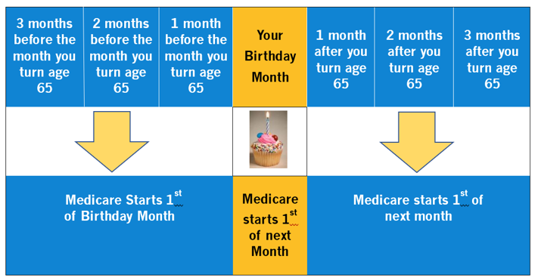
Initial Enrollment Period
Notes:
For my ‘sharpshooters’: if your birthday is the first day of the month, you are eligible as of the first day of the prior month! Just shift the entire calendar forward one month.

Slide 25
Enrollment has rules – of course
A person who does not enroll before the end of the third month after their 65th birthday month, may be ‘late’ and face a late-enrollment penalty.
This rule applies to enrollment in:
Medicare Part B
Medicare Part D

Slide 26
Special Enrollment Period
You are covered by a group health plan based upon current employment.
  Your own, a spouse’s or, if disabled, then a family member’s.
Enroll
Any time still covered by the group health plan.
During the eight-month period that starts the month after employment ends or the coverage ends, whichever happens first.
Notes:
Occurs after the Initial Enrollment Period (IEP) ends.

Slide 27
Complexities abound
There are many complex rules about the timing of enrollment and continuous coverage and creditable coverage – all important.
I am highlighting this section and not showing you a picture because I am urging you to manage enrollment with no break in coverage

Slide 28
Scenario #2
Paul is 67 years old, now. Feeling great. Ready to retire. He talked with DRS and his retirement will be based on his anniversary of service date. His last day on the job will be August 31, 2026.
Hey, SHIBA volunteer…

Slide 29
In the form of a question?
I will be retiring in about 90 days.
I need to sign up for Medicare, now, right?
I want to get this right the first time!

Slide 30
The SHIBA volunteer says
Congratulations, Paul. We’re grateful for your service.
Let’s talk about your plans for Medicare and other insurance in addition to Medicare.
You’re going to need to enroll in Medicare Part A and Medicare Part B. You can do that on-line right away.
The next bit is about whether you’ll continue coverage in a group health plan – as a retiree or as a dependent on a spouse’s group health plan.

Slide 31
Knowledge check
True or False?
It can be OK to wait to sign up for Medicare, after I turn age 65?
no penalties

Slide 32
Part 1: Eligibility and enrollment
When you are eligible, enroll on time.
In general, that means to coincide with the first day of the month after your last day of active employment.
You might need to reach out to SSA to enroll yourself, if you are not receiving a cash benefit or if you deferred enrollment.
Plan to do that about 3 months ahead of time.

Slide 33
Approaches

Slide 34
Medicare in context
Notes:
The left-hand side of the chart shows how original Medicare – also called “fee-for-service” Medicare works.
Beneficiaries access benefits for Part A – hospital – and Part B – medical – through providers that contract with Medicare (CMS).
Medicare prescription drug benefits are provided through private companies: stand-alone Part D plans.
The right-hand side of the chart shows how Medicare Advantage plans work.
Beneficiaries access benefits for Part A and Part B and Part D through providers that contract with private companies that contract with Medicare (CMS).

Slide 35
Approaches to Medicare coverage
Original Medicare
Medicare Advantage
Medicare Part C
Medicare Part A
  Hospital (inpatient)
Medicare Part B
  Medical (outpatient)
Medicare Part D
  Prescription drug plans
Medicare Advantage – Prescription Drug
  (MA-PD) plans
  Consolidate in one package
    Hospital (inpatient)
    Medical (outpatient)
    Prescription drugs
    Additional benefits

Slide 36
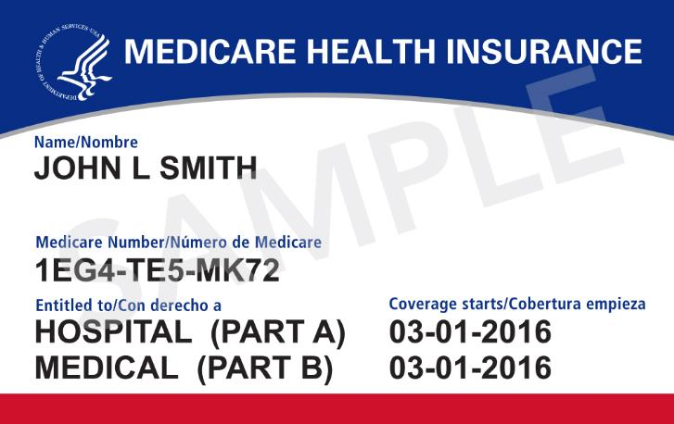
Medicare card
Notes:
Here is a standard issue ‘red-white-and-blue’ Medicare card.

Slide 37
You may need more insurance
Services not covered by Medicare
Part A deductible, coinsurance, co-pays
  And services not paid 100%
Part B deductible, coinsurance, co-pays
  And services not paid 100%

Slide 38
Not covered by Medicare
Prescription drugs
Most dental care
Eye exams (nor prescription glasses)
Massage therapy, chiropractic care
Hearing aids and exams for fitting them

Slide 39
Choosing the approach
There are pro’s and con’s to each approach
These are very personal, of course
Before we talk about details for coverage, let’s focus on options and costs
Notes:
We get lots of questions about sort of pro’s and con’s, the merits of one approach compared to another approach.
I would like to talk about that very briefly, time permitting, but I'm sure we will deal with it in the question-and-answer period.

Slide 40
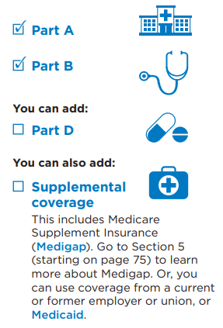
Original Medicare
Recommended reading.
Medicare & You 2024 Handbook
Emphasis added
Notes:
I’ve copied this for the 2024 version of the Medicare & You handbook.

Slide 41
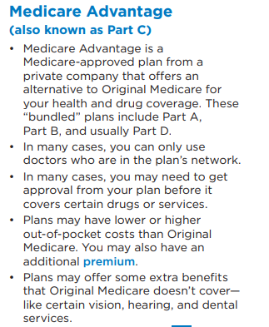
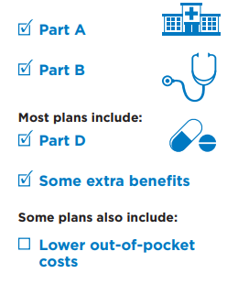
Medicare Advantage
Notes:
In a Medicare advantage plan, the covered benefits and services for Medicare, Part A and Part B and Part D are included as part of a comprehensive package.
NOTE: this does not mean that the out-of-pocket costs are the same in each approach- they are not.

Slide 42
Coverage in addition to Medicare
Notes:
So, more than 90% of people elect other insurance in addition to Medicare.
Employment-related insurance, from the place we used to work, is common – that’s you: HCA Medicare retirees.
These are not exclusive categories. Specifically, ½ of employment-related coverage was in MA plans and ½ of Medicaid coverage was in MA plans. So, total enrollment in MA plans was nearly 45%. It’s over 50% now.
These are data for 2020, from the Kaiser Family Foundation review of the Medicare data.

Slide 43
Part 2: Approaches
90% of people elect some coverage in addition to Medicare Part A and Part B
Medicare offers two different and exclusive approaches for beneficiaries
  Original Medicare
  Medicare Advantage
These approaches apply to group health plans, plans sold to individuals, and plans sponsored by Medicaid as well

Slide 44
Costs for coverage
Premiums

Slide 45
Options for retirees, Part 1
Group health plan
Join the group
Defer joining the group
Decline joining the group
  COBRA as an option is ‘tricky’ – be sure to ask for expert help
Notes:
I am going to present options in a set of three:
Enroll in a group health plan, if offered
Enroll as an individual
Elect original Medicare
Elect Medicare Advantage

Slide 46
Options for retirees, Part 2A
Elect ‘original Medicare’
Enroll in Medicare Part D
  Use other creditable coverage
Purchase a Medicare supplement (“Medigap”) plan

Slide 47
Options for retirees, Part 2B
Elect Medicare Advantage-Prescription Drug (MA-PD) plan
There are HMO and PPO plan types

Slide 48
Premiums, by approach
Original Medicare
Medicare Advantage-Prescription Drug plan
Part A
Part B
Part D
Medicare supplement plan
Part A
Part B
MA-PD plan

Slide 49
Premiums and enrollment
As a general rule, group health plans will require Medicare-eligible subscribers and dependents to enroll in Medicare Part A and Medicare Part B, in order to continue post-employment benefits
For people who choose coverage as individuals, Medicare supplement plan and Medicare Advantage plan require enrollment in both Medicare Part A and Medicare Part B

Slide 50
Medicare Part A
For most people, there is no monthly premium for Medicare Part A
Your contributions to the Medicare Trust Fund - while you were working - pay these costs
There are people who pay a Medicare Part A premium, based on their limited contributions to the Fund.

Slide 51
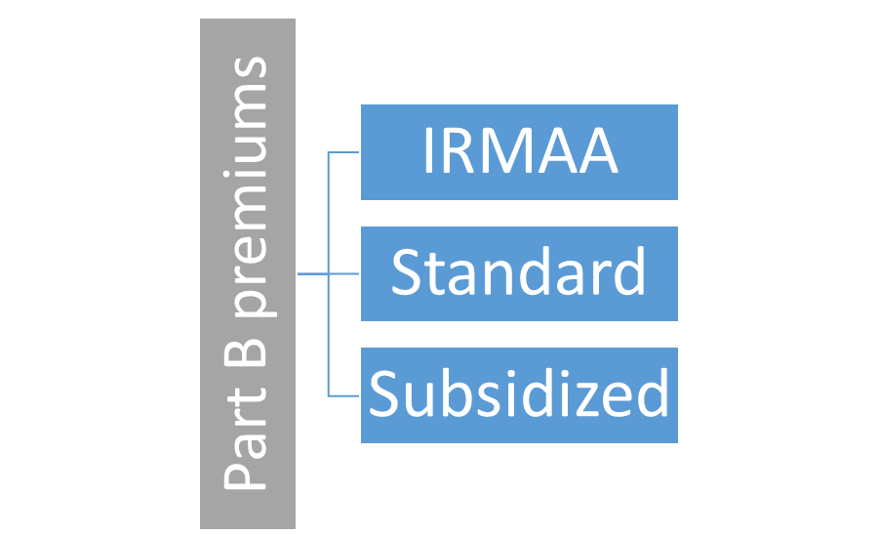
Medicare Part B
Notes:
The total of Medicare Part B premiums is based on the forecast for spending, by the Federal government, for Part B covered services, in the year ahead.
Beneficiaries pay 25% of that total.
What each beneficiary pays is based on their monthly income.
Highest income beneficiaries are assessed a surcharge. This is called the ‘income related monthly adjustment amount.’
Most beneficiaries pay the standard monthly Part B premium: $174.70 per month.
Beneficiaries with very low monthly incomes can have the Part B premium paid on their behalf, by a joint federal-state program.
For my experts out there, it’s true that there are other ‘less that standard’ rates besides full subsidy.

Slide 52

Medicare Part D
Notes:
Turning first to what we call ‘stand-alone’ Part D plans – which a person who elects original Medicare as their approach would buy.
What each beneficiary pays is based on their monthly income.
The standard premium is the rate published by the insurance company that sells the Part D plan.

Slide 53
Medicare supplement plans
These are standardized plans sold by private insurance companies.
The coverage varies by the plan.
The monthly premium is determined by the individual company.
What does each type of plan cover?
Plans for sale in WA
Notes:
This can confuse people – especially people in group health plans.
There are insurance products that are, explicitly, Medicare supplement plans.
Some retirees do have access to these plans as part of their portfolio.
The HCA PEBB offers Plan G , with Premera
There are other kinds of insurance that help with the costs for Medicare covered services and often provide more benefits that Medicare does not – like prescription drugs. People want to call these ‘supplement’ plans because they complement and pay secondary after Medicare. But these are not Medicare supplement plans.

Slide 54
Original Medicare approach: summary
To purchase a Medicare Part D plan, you must have either Medicare Part A or Medicare Part B
To purchase a Medicare supplement plan, you must have both Medicare Part A and Medicare Part B
Being timely matters
  There may be delayed enrolled
  There are late-enrollment penalties for Part A (if there is a premium), Part B and Part D

Slide 55

Medicare Advantage-Prescription Drug (MA-PD) plan
Notes:
The standard premium is the rate published by the insurance company that sells the MA-PD plan.
Because the Part D benefit is included in the package, any amended monthly rate will reflect the surcharge for the highest-income beneficiaries or the subsidy for very low-income beneficiaries.

Slide 56
Medicare Advantage approach: summary
To purchase a Medicare Advantage (Part C) plan, you must have both Medicare Part A and Medicare Part B
Being timely matters
  There may be delayed enrolled
  There are late-enrollment penalties for Part A (if there is a premium), Part B and Part D

Slide 57
Review of premium charges
 | Original Medicare | Medicare Advantage Prescription Drug (MA-PD) plan
Part A | No premium for most | No premium for most
Part B | Range, based on income | Range based on income A few products include partial ‘give-back’ of premium, in contract
Part D | Market cost set by company + Medicare-set, based on income (range) | Market cost set by company + Medicare-set, based on income (range)
Medicare supplement | Market cost set by company | Not permitted (duplicate coverage)

Slide 58
Premiums
Premium payments for Medicare Part B are required in order to purchase a group health plan, in most cases
The cost of premiums varies quite a lot depending upon several factors
  Approach to additional coverage
  Plan selection
  Personal income

Slide 59
Covered benefits

Slide 60
Defined contribution
You might think about Medicare as ‘defined contribution’ system – not a defined benefit system
The options you have vary widely
  group health plan v. individual enrollment
  Original Medicare v. Medicare Advantage
And that’s before we get to choosing a plan and a provider and there are lots of things that we can’t control that affect us, too
  Geography, technology, language, disability

Slide 61
Scenario #3
Paul has been busy. He’s read over the materials that the plan administrator (HCA) posted online, and he’s studied the Medicare program, too. He just needs a consultation about the covered benefits for each plan. And he’s concerned about access to his doctor.

Slide 62
In the form of a question?
I understand the approaches. I know what I care about most.
Can you help me wade through the details?
I need to decide and have some peace of mind.

Slide 63
The SHIBA volunteer says
Hi, again, Paul.
You’ve completed the heavy lifting – well done.
Here is the general guidance:
Read the evidence of coverage and summary of benefits – focus on the things you care most about
Make sure you understand your rights and protections
Ask lots of questions
Remember: no matter what you have Medicare

Slide 64

SHIBA is for you
Notes:
I wrote this program like YOU and Medicare because it’s about YOU.
We believe in person-centered counseling.
You are the reason we’re here.
Medicare is a complex and changing system that requires you to be engaged very intensively. In addition to that, you may be contending with the challenges of a group health plan, too.
We’d like to help.
And if you’d like to help us, we’d like to talk about opportunities to be a trained volunteer advisor.
Thank you.

Slide 65
Ignorance is NOT bliss
There are real consequences
  not knowing your rights
  being late to take action
  not knowing who to trust for help
There is a real emotional toll to being
  confused or scared or feeling isolated or lonely
Notes:
Friends, this is serious business. The stakes are high.

Slide 66
Questions & answers

Slide 67
Q & A time
Audience questions and commentary:
Opinions are not facts, but both matter.
Civility and respect are invaluable.
Humor and perspective and humility are gold.
6

Slide 68
How to contact SHIBA
Phone:
1-800-562-6900
TDD: 360-586-0241
TDD Relay: 1-800-833-6384
The web:
www.insurance.wa.gov/shiba

