Slide 1


INSURANCE ISSUES
TACOMA HOUSING AUTHORITY
Erika Munoz
Risk Manager
902 S L St, Tacoma WA 98405
253-691-2729
emunoz@tacomahousing.org

Slide 2
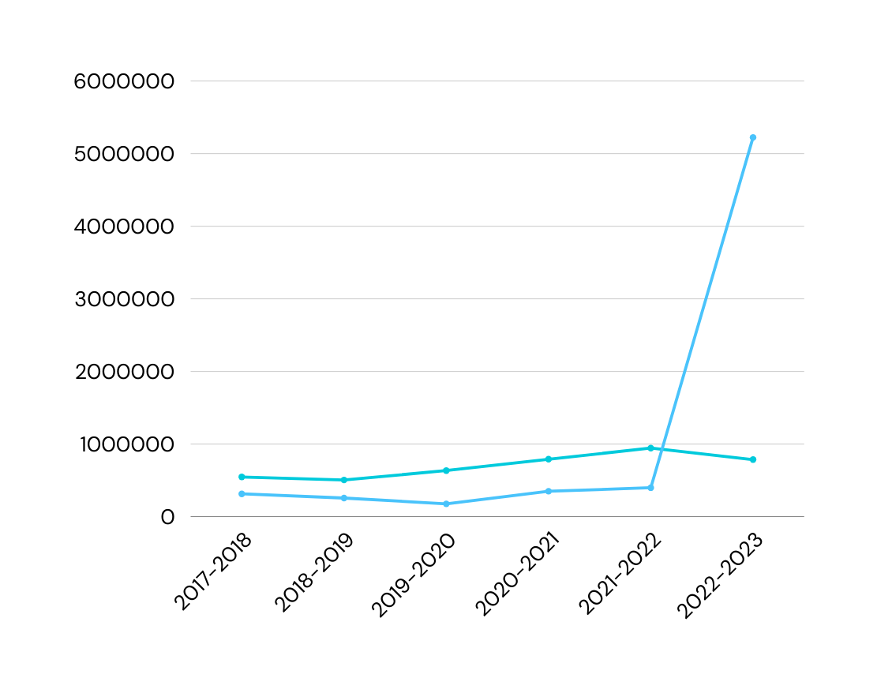
THA LOSS TREND 2017-2023
1
THA Averaged 17 Claims Per Year
From 2017-2022 Loss Ratio range from 27.80% to 57.36%
In 2023, Loss Ratio was 664.89%
Total Incurred Cost for 2023 $5,223,233

Slide 3
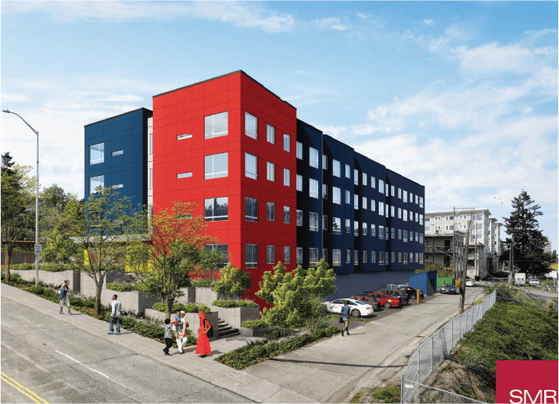

MAJOR LOSS IN 2023
2
The RISE - Water Loss
  A tenant opened the standpipe on the 4th-floor stairwell.
  59 out of 64 units were impacted and temporarily relocated during the incident.
  The total value loss claim from this incident was $3,231,048.00.
  Most tenants return to their units within 3 months of the incident.
  Reconstruction took 1 year and 1 month to complete due to back ordered materials for the elevators.
Risk Prevention
  To mitigate future losses from similar incidents, THA applied for and was awarded a grant from State Farm, which allowed THA to purchase Knox Standpipe locks for all mid-rise properties in our portfolio.

Slide 4
INSURANCE NON-RENEWAL
3
09/19/2023
11/1/2023
Finding A New Carrier
Present
THA was issued a notice of non-renewal from our carrier, Philadelphia Indemnity due to a high risk loss ratio.
Our coverage with Philadelphia was set to expire on 11/1/2023. Philadelphia was our carrier for the previous 9 years.
Alliant (THA’s broker) went to market with our information to multiple carriers to find new coverage. THA also reached out directly to HAI Group.
THA was able to get affordable coverage through HAI Group, a member-owned organization founded by, and dedicated to serving, the public and affordable housing communities.

Slide 5

MARKETING EFFORTS
4
1. Alliant went to market and heard back from 27 potential carriers for THA. Most declined to quote.
2. THA received 2 quotes from Insurance Carriers for Primary Coverage.
3. THA received 1 quote from Insurance Carriers for Excess Coverage.
4. The quotes provided by Alliant were a 267.65% increase from the prior year. We were able to place most property/GL coverage through HAI Group at a 147.23% increase.

Slide 6

INSURANCE RENEWAL PROCESS
5
The policies were broken apart by properties. We had to recreate our Schedule of values based on individual buildings and square footage.
Our previous broker placed standalone policies for Cybersecurity, Sexual Abuse/Molestation, Public Officials/EPL, and Crime.
Unable to place coverage for our commercial buildings (James Center North) or our permanent supportive housing buildings through HAI Group. Our broker was able to place these with minimal policy options.
STANDALONE POLICIES
PROPERTIES
NO COVERAGE

Slide 7
THA INSURANCE PREMIUMS 2023-2024
6
Tacoma Housing Authority – 3 Year Premiums
 | 2021-2022 | 2022-2023 | 2023-2024 Premium Only | 2023-2024 Est. Surplus Lines Taxes/Fees | 2023-2024 Alliant Estimated Grand Total | 2023-2024 Actual Grand Total | Erika Notes
Property | $789,484 | $891,897 | $2,500,000 | $50,250 | $2,550,250 | $1,453,205 | HAI Group - Unable to cover JCN and Prairie Oaks - Waiting to ensure Arlington CRC is covered
Property - 6th Ave and Arlington Heights Apts only | Incl in Prop | $107,160 |  |  |  |  | HAI Group Property covered
Property - JCN |  |  |  |  |  | $55,279 | Alliant - HAI Group wouldn't cover due to risk
GL/Excess - JCN |  |  |  |  |  | $55,187 | Alliant - HAI Group wouldn't cover due to risk
Property - Prairie Oaks |  |  |  |  |  | $22,916 | Alliant - HAI Group wouldn't cover due to risk
James Center North EQ | $12,558 | $13,700 |  |  |  | $18,414 | Alliant
GL- including EBL, PL, SML and Stop Gap | $93,506 | $115,997 | $495,000 | $9,950 | $504,950 | $99,018 | HAI Group
AL | $84,120 | $112,639 | $295,000 | $5,930 | $300,930 | $89,511 | HAI Group - Bind confirmed - This does not include PIP which I asked for basic coverage
Sexual Abuse Molestation (1M Limit) | Incl in GL | Incl in GL | $25,000 | $503 | $25,503 | $44,414 | Alliant - Bind confirmed
Umbrella | $33,885 | $42,545 | $250,000 | $5,025 | $255,025 |  | HAI Group Excess instead
Excess |  |  |  |  |  | $83,046 | HAI Group
Public Officials/EPL | $38,431 | $42,460 |  |  |  | $52,747 | Alliant
Cyber (12/1/22-23 renewal) | $28,062 | $32,350 |  |  |  | $26,758 | Alliant quoted - working to gather more info. Potential price drop to $26k through different carrier
Human Services - POTENTIAL/NOT REQUIRED |  |  |  |  |  | NOT REQUIRED | HAI Group - Filling out application. This coverage may not be necessary.
Tenant Discrimination - POTENTIAL/NOT REQUIRED |  |  |  |  |  | NOT REQUIRED | Alliant checking if we had coverage through PHLY. May apply through HAI Group. This coverage may not be necessary
TOTAL | $1,067,488 | $1,358,748 | $3,565,000 | $71,657 | $3,636,657 | $2,000,495

Slide 8
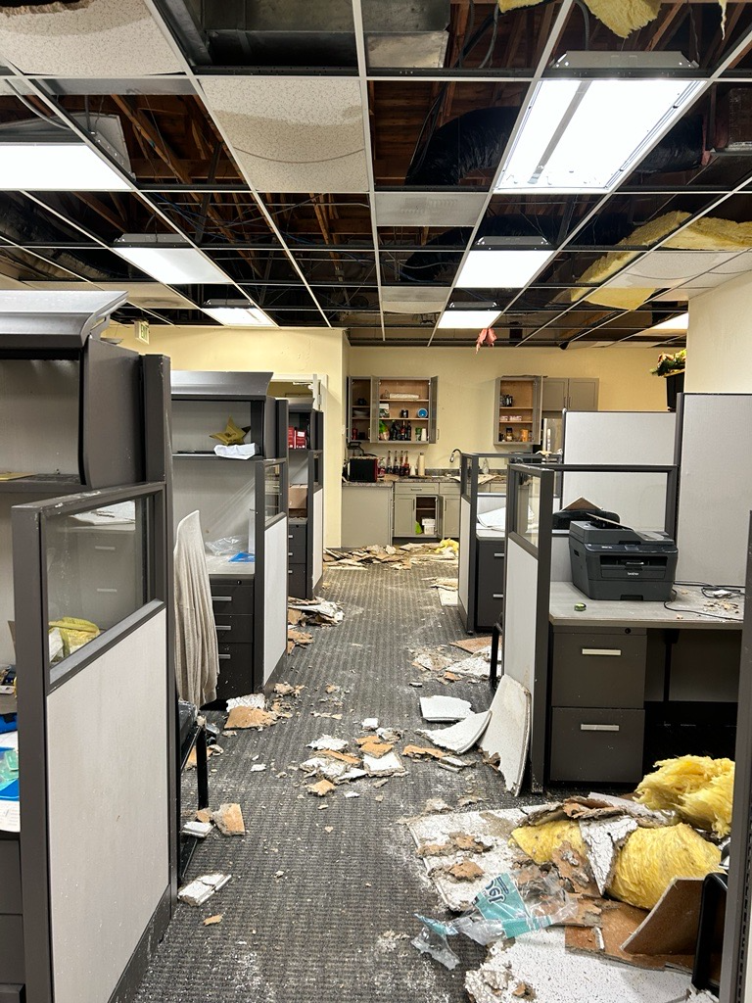
CONTINUAL ISSUES WITH CURRENT COVERAGE
7
2024 Winter Freeze
We had a major water loss at James Center North and Prairie Oaks properties over MLK Weekend, due to frozen Pipes
James Center North
Our new carrier for James Center North have been minimally responsive. We are unsure what the policy will cover due to the lack of information. The current loss total is $250,000.
Prairie Oaks
The policy we were able to place for Prairie Oaks included a sub-limit for water damage. The current loss total is $479,000. THA will have to pay $379,00 out of pocket for this loss

Slide 9
THANK YOU
Presented By : Erika Munoz

