Slide 1

Take Charge…
Help Prevent Health Care Fraud and Abuse!
Presented by Statewide Health Insurance Benefits Advisors (SHIBA), Washington state’s SMP
SMP program funded by the U.S. Administration for Community Living
Notes:
SMP Group Education PowerPoint Presentation, 30-minute version: Revised December 2017
Notes that are in italics are meant as notes to the facilitator, not to be read aloud. Notes that are not in italics are meant to be read with the slide.
Suggested Content & Timing: 30-minute presentation
Consequences of Fraud, Errors, and Abuse: 4 minutes
SMP Program and Mission: 2 minutes
Medicare Overview: 7 minutes
Medicare Fraud, Errors, and Abuse: 4 minutes
Examples of Fraud and Abuse (stories): 2 minutes
Protect, Detect, Report: 7 minutes
Volunteering with the SMP: 1 minute
Q&A Session: 3 minutes
Publications to order from Fulfillment and bring to presentation:
Personal Health Care Journal, SHP862
Stop Medicare fraud fact sheet, SHP 800
Order from SMP Resource Library
MSN Fact Sheet (you will need to sign in to www.smpresource.org)
Tips
If possible, have your partner organization introduce you.
Do something creative to get the audience’s attention right away, especially with shorter presentations. See the SMP Group Education Training Manual for suggestions and additional information.
Suggested Script
Thank you for allowing me to take a few minutes of your time. My name is (name) and I am here with the (State) Senior Medicare Patrol program. In today’s presentation, I will talk to you about Medicare fraud and abuse, how they affect YOU, and how you can take charge to help prevent fraud and abuse in three easy steps: protect, detect, and report.

Slide 2

Medicare Fraud, Errors, and Abuse Affect…
Everyone
  Billions of taxpayer dollars lost to improper claims
  Medicare trust fund at risk
Medicare Beneficiaries
  Higher premiums
  Less money for needed benefits
  Quality of treatment
Notes:
Suggested audience interaction to introduce this slide – ask the audience:
How many of you are Medicare beneficiaries? (raise hands)
How many of you are caregivers? (raise hands)
How many of you pay taxes? (raise hands)
You might be wondering, why should I care about Medicare fraud? Well, Medicare fraud, errors, and abuse affect everyone!
Each year, Medicare loses BILLIONS of taxpayer dollars to improper claims.
This puts the Medicare trust fund at risk for everyone and affects the future of the Medicare program.
Medicare fraud, errors, and abuse also affect current Medicare beneficiaries because they result in higher Medicare premiums and waste money that could be used to increase and improve health care services.

Slide 3
Consequences of Medicare Fraud, Errors, and Abuse
Medical identity theft
Health impact
Personal financial losses
Notes:
Medicare fraud, errors, and abuse can also cause serious personal consequences for beneficiaries, such as medical identity theft, negative health impacts, and personal financial losses.
Medical Identity Theft
Medical identity theft occurs when a beneficiary’s Medicare number is misused, either by a provider, a supplier, or by someone posing as the real beneficiary in order to receive medical care. Such Medicare numbers are considered “compromised.” Medicare numbers are for life, even if stolen or misused, so a beneficiary whose number is compromised may be affected forever by false claims against his or her Medicare number.
Health Impact
Receiving health care from a fraudulent provider can mean the quality of the care is poor, the intervention is not medically necessary, or worse: The intervention is actually harmful. A beneficiary may later receive improper medical treatment from legitimate providers as a result of inaccurate medical records that contain:
False diagnoses
Records showing treatments that never occurred
Misinformation about allergies
Incorrect lab results
Additionally, because of inaccurate or fraudulent claims to Medicare, beneficiaries may be denied needed Medicare benefits. For example, some products and services have limits. If Medicare thinks such products and services were already provided, they will deny payment.
Personal Financial Losses
Medicare fraud, errors, and abuse can all result in higher out-of-pocket costs for beneficiaries, such as copayments for health care services that were never provided, were excessive, or were medically unnecessary. Beneficiaries may also find themselves stuck with bills for services from providers who should have billed Medicare but instead billed the beneficiary for the entire cost of that service. Finally, because Medicare numbers also contain Social Security numbers, financial fraud can be a side effect of having one’s Medicare number compromised. Medicare numbers are as valuable as Social Security numbers to thieves who wish to set up credit card accounts with someone else’s identity.
Also, there may be legal consequences for beneficiaries who are complicit in fraud and abuse, since participating in schemes to defraud Medicare is illegal!

Slide 4
What is the Senior Medicare Patrol?
SMPs...
Help preserve the integrity of the Medicare program
Rely on volunteers to help perform SMP work
Help Medicare beneficiaries prevent, detect, and report health care fraud
Notes:
The Senior Medicare Patrol is here to help you avoid these problems.
Senior Medicare Patrol programs, or SMPs, help Medicare and Medicaid beneficiaries prevent, detect, and report health care fraud. By doing so, we help preserve the integrity of the Medicare and Medicaid programs. Because this work often requires face-to-face contact to be most effective, SMPs nationwide rely on approximately 5,000 volunteers who are active each year to help in this effort.
Suggested Handout: SMP Brochure (available in multiple languages)
www.smpresource.org > Resources for SMPs > SMP Resource Library

Slide 5

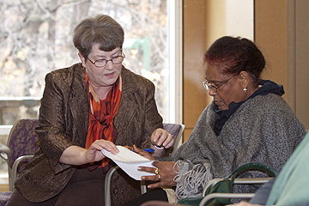

The SMP mission is…
to empower and assist Medicare beneficiaries, their families, and caregivers
to prevent, detect, and report health care fraud, errors, and abuse
through outreach, counseling, and education.
Notes:
Education and prevention are at the core of the Senior Medicare Patrol program, as demonstrated by its mission: (read the slide)

Slide 6
What is Medicare?
Federal health insurance program created in 1965
And a few others
Some people with disabilities under 65
Not designed to pay 100% of all medical bills
Covers over 52 million people
People ages 65 and older
Notes:
What is Medicare?
Medicare is the federal health insurance program created in 1965 for people ages 65 and older, some people with disabilities under 65, and a few others, such as those with End-Stage Renal Disease (ESRD) and certain people with ALS (Lou Gehrig’s disease or amyotrophic lateral sclerosis). The Medicare program was NOT designed to pay 100 percent of all medical bills. In 2013, according to the Medicare Trustees report, Medicare covered over 52 million people: 43.5 million people age 65 and older and 8.8 million people with disabilities.

Slide 7
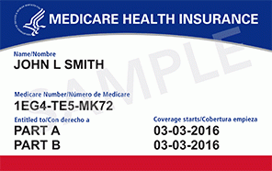
Medicare Numbers and Cards
All Medicare beneficiaries are issued a Medicare number and card upon enrollment.
Medicare numbers contain a unique beneficiary ID number. A Medicare number is as valuable to identity thieves as a credit card.
Notes:
Medicare beneficiaries are issued a Medicare number upon enrollment. Everyone enrolled in Medicare is also issued a Medicare card. It is then used like any other insurance card.
Medicare cards up until April 2018, contained the beneficiary’s Social Security number, now they contain a unique ID number for each beneficiary. You still want to keep this number safe.

Slide 8
Parts of Medicare
Part A: Hospital Insurance
Part B: Medical Insurance
Part C: Medicare Advantage
Part D: Prescription Drugs
A + B = Original Medicare
Medicare Supplement Insurance (Medigap) is not part of Medicare
Notes:
Medicare consists of four parts called Part A, Part B, Part C, and Part D.
Medicare Part A and Part B together are known as “Original Medicare.”
Beneficiaries in Original Medicare have the option of purchasing supplemental insurance to cover gaps in coverage. However, Medicare supplement insurance (also known as Medigap) is not part of Medicare.
Medicare Part C offers an alternate system for delivering the same services as Original Medicare through private insurance plans, called Medicare Advantage Plans.
Lastly, Medicare Part D insurance delivers prescription drug coverage through certain Medicare Advantage Plans or through standalone Medicare Prescription Drug Plans.

Slide 9

Part A: Hospital Insurance
Health care benefits help cover:
Inpatient hospital care
Inpatient skilled nursing facility care
Home health care
Hospice care
Notes:
Medicare Part A is also referred to as Hospital Insurance.
Part A provides health care benefits that help cover the following services:
Inpatient hospital care
Inpatient skilled nursing facility (SNF) care
Home health care
Hospice care

Slide 10

Part B: Medical Insurance
Health care benefits help cover:
Doctor services
Durable medical equipment (DME)
Home health care
X-rays, lab services
Outpatient hospital services
Mental health services
Most preventive health care services
Notes:
Medicare Part B is also referred to as Medical Insurance.
Part B provides health care benefits that help cover the following services:
Doctor services
Durable medical equipment (DME)
Home health care
X-rays, lab services
Outpatient hospital services
Mental health services
Most preventive health care services (“Welcome to Medicare” or yearly “Wellness” visits)

Slide 11

Part C: Medicare Advantage
An alternative to Original Medicare (Parts A and B) when elected
Offered by private insurance companies
Must provide all Part A and Part B benefits
Many offer additional benefits
Most include prescription drug coverage
Coverage varies!
A plan comparison tool is available on Medicare’s website: www.Medicare.gov
Notes:
Medicare Part C, more commonly called Medicare Advantage, is an alternative to Original Medicare when elected by a Medicare beneficiary. Medicare Advantage Plans are offered by private insurance companies that sign a contract with Medicare. Medicare Advantage Plans must provide all Medicare Part A and Part B benefits to plan members. Many offer benefits that Original Medicare doesn’t cover, such as routine hearing, vision, and dental care and nonambulance medical transportation services. Most Medicare Advantage Plans also include Medicare Part D prescription drug coverage. Beneficiaries are encouraged to compare plans prior to enrolling because coverage varies. A plan comparison tool is available on Medicare’s website: www.Medicare.gov.

Slide 12
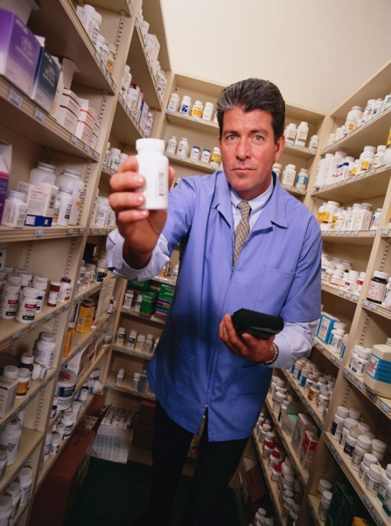
Part D: Prescription Drugs
Help with prescription drug costs
Offered by private companies
Coverage varies!
A plan comparison tool is available on Medicare’s website: www.Medicare.gov
Notes:
Medicare Part D is also referred to as Medicare Prescription Drug Coverage. The Centers for Medicare & Medicaid Services (CMS) contracts with private companies to offer Medicare Prescription Drug Plans to people with Medicare.
Beneficiaries are encouraged to compare plans prior to enrolling because coverage varies. The drugs covered, copayment amounts, deductibles, and coverage in the gap or "donut hole" differ from plan to plan. A plan comparison tool is available on the Medicare website: www.Medicare.gov.

Slide 13

What is Medicare Fraud?
Intentionally billing Medicare for services that were not received or billing for a service at a higher rate than is actually justified
Notes:
Now that we’ve learned a little bit about Medicare, let’s look at Medicare fraud.
Medicare fraud involves intentionally billing Medicare for services that were not received, or billing for a service at a higher rate than is actually justified.

Slide 14

What is Medicare Abuse?
Providers supply services or products that are not medically necessary or that do not meet professional standards
Notes:
Next, what is Medicare abuse?
Medicare abuse occurs when providers supply services or products that are not medically necessary or that do not meet professional standards. Medicare fraud and abuse are very similar and many times overlap.

Slide 15
Examples of Fraud & Abuse
Billing for services, supplies, or equipment that were not provided
Billing for excessive medical supplies
Obtaining or giving a Medicare number for “free” services
Improper coding to obtain a higher payment
Unneeded or excessive x‐rays and lab tests
Claims for services that are not medically necessary
Using another person’s Medicare number, or letting someone else use your number
Notes:
Here are some examples of fraud and abuse:
Billing for services, supplies, or equipment that were not provided
Billing for excessive medical supplies
Obtaining or giving Medicare number for “free” services; treat any offer of free services in exchange for your Medicare or health care identification number with caution
Improper coding to obtain a higher payment
Unneeded or excessive x‐rays and lab tests
Claims for services that are not medically necessary
Using another person’s Medicare number, or letting someone else use your number, to obtain medical care, supplies, or equipment

Slide 16

Examples of COVID-19 SCAMS
Scammers offer free Corona tests
Price-Gouging high-demand items
Phony Contact Tracing Calls or Text messages
Con artists offer free Vaccine
Notes:
And here are some examples of what Con artists are doing – though they often change tactics so by the time you see this there may be more COVID-19 related scams.
Some scammers are calling and offering free coronavirus test. Others are offering Protective equipment, hand-sanitizers and other high-demand items that people are clamoring for during this pandemic.
Scammers are offering free Coronavirus tests and testing kits.
Lately con artists are using email and text messages to let people know they’ve been in contact with someone that tested positive. All the recipient needs to do is click on a link. Then that link can infect your device or laptop, steal emails.
Be wary and never give out your personal, financial or confidential information to someone you don’t know. Do not click on links that may be from someone you do not know.
And regarding those free coronavirus tests and free vaccines, at this time there is no FDA approved coronavirus vaccine or cure for COVID 19.

Slide 17

Be cautious!
Notes:
Be cautious of all calls, texts, emails, letters or visitors selling COVID-19 test kits or anything related to COVID.
Ultimately what all the scam artists are trying to do is to separate you from your Medicare number and/or your credit card number and/or your personal information.

Slide 18

What about Errors?
Health care services and billing are complicated, which can lead to errors.
Only a review and investigation of the issue will determine if it is an error, fraud, or abuse.
Notes:
In addition to fraud and abuse, it’s also important to consider errors. Providing and billing for health care services involves many of complicated steps, which may lead to errors. Most Medicare payment errors are simply mistakes and are not the result of physicians, providers, or suppliers trying to take advantage of the Medicare system.
Sometimes what may seem like a simple error can turn out to be fraud or abuse, and what might appear to be fraud or abuse can be a simple error. Only a review and investigation of the issue will determine whether it is an error, fraud, or abuse.

Slide 19

Real Life Cases:
Medicare Fraud & Abuse in Washington state!
Seattle doctor pleads guilty to turning in phony Medicare claims including reports of nursing home visits to patients who were dead.
Notes:
Share this real life fraud case:
A Seattle doctor accused of turning in phony Medicare claims that included reports of nursing-home visits to patients who were dead says he will plead guilty.
John C. Chen was charged in North Dakota federal court with six counts, including health-care fraud and false statements related to health care. The charges carried a combined maximum penalty of 45 years in prison.
The case was heard in North Dakota because Fargo-based Noridian Healthcare Solutions processes and pays Medicare Part B claims in Washington state. Medicare Part B helps to pay for certain physician and outpatient services.
Authorities said Chen submitted 673 claims for medical services in the Seattle-Tacoma area from 2007 through 2010, when he was out of the country. Another 212 claims were filed between April 2007 and July 2012 for nursing-home visits that never took place, according to court documents.
It’s not clear how many claims Chen submitted for services he said he performed on certain dates after patients had died.
Doctors are allowed to bill Medicare for evaluation and management services provided to patients in skilled nursing facilities, but they must be deemed “medically necessary” and the doctor must personally document the need for services in the patient’s medical record. The indictment said Chen failed to keep accurate notes of patient records.
The government asked Chen to pay back any losses and forfeit all property and proceeds he gained as a result of the scheme. Those damages were not specified.

Slide 20

Three Steps to Prevent Health Care Fraud
Protect
2) Detect
3) Report
Notes:
So, what can YOU do to take charge and help prevent Medicare fraud, errors, and abuse? I am here to tell you how in three easy steps: protect, detect, and report.

Slide 21

Step 1: Protect Yourself and Others from Medicare Fraud
Do treat your Medicare card and number like your credit card.
Do watch out for identity theft.
Do be aware that Medicare doesn’t call or visit to sell you anything.
DON’T
Don't give out your Medicare number except to your doctor or other Medicare provider.
Don’t carry your Medicare card unless you will need it.
DO
Do be cautious of offers for “free” medical services.
Do pass it on!
Notes:
First, protect yourself and your loved ones from Medicare fraud and abuse!
Do treat your Medicare and Social Security cards and numbers like your credit card. Don't give out your Medicare number except to your doctor or other Medicare provider. Don’t carry your Medicare card unless you will need it. Only take it to doctors’ appointments, visits to your hospital or clinic, or trips to the pharmacy.
Do watch out for identity theft. Scam artists will not only use your Medicare number to defraud the Medicare system, but this is also one way that people can steal your identity, since your Social Security number is typically included in your Medicare number!
Do be aware that Medicare doesn’t call or visit to sell you anything. However, Medicare does now require their contractors to contact beneficiaries from time to time, so make sure to be vigilant. Keep in mind that you don’t have to talk to anyone who calls you or shows up at your door who you do not trust…Medicare contractors will understand.
Do be cautious of offers for “free” medical services. If it sounds too good to be true, it probably is!
Do pass it on! Share this information with friends and family members who might not already know how to prevent Medicare fraud and abuse.

Slide 22



Step 2: Detect Medicare
Fraud & Abuse
Review Medicare Summary Notices (MSNs) and other statements for:
1. Services you didn’t receive
2. Double billing
3. Services not ordered by your doctor
Notes:
Second, detect Medicare fraud and abuse:
Even when you do everything right, there is a chance that you could be a target of health care fraud. There are many ways that your personal information can be used without your permission.
Always review your Medicare Summary Notice and Explanation of Benefits for mistakes.
Look for three things on your billing statements:
1. Charges for something you didn’t receive
2. Billing for the same thing twice, and
3. Services that were not ordered by your doctor
Suggested Handout: MSN Fact Sheet (available in multiple languages)
www.smpresource.org > Resources for SMPs > SMP Resource Library
Tip: If you have time, hand out the MSN Fact Sheet and review it with the group. Explain how to use your MSN to detect fraud, errors, and abuse, and review the information to look for in each type of statement.

Slide 23

Step 2: Detect Medicare Fraud & Abuse, continued
Access your Medicare information online at www.MyMedicare.gov.
View recent MSNs
Track claims made on your behalf
Check payment status
And more!
Notes:
Medicare Summary Notices are typically sent on a quarterly basis. To better detect potential issues, you can access your Medicare information online! www.MyMedicare.gov is a helpful tool for beneficiaries to view their most recent MSNs, track claims made on their behalf, and check payment status. Once you register, access to your current Medicare account is available 24 hours a day.
At MyMedicare.gov, you can also:
Check Part B deductible status
View eligibility information
Track available preventive services
Find Medicare health or prescription drug plans
Access Part D plan claims information
MyMedicare.gov has the potential to serve as a valuable, real-time tool in combating fraud and abuse. If you have Medicare and access to a computer, this might be a good option for you.

Slide 24
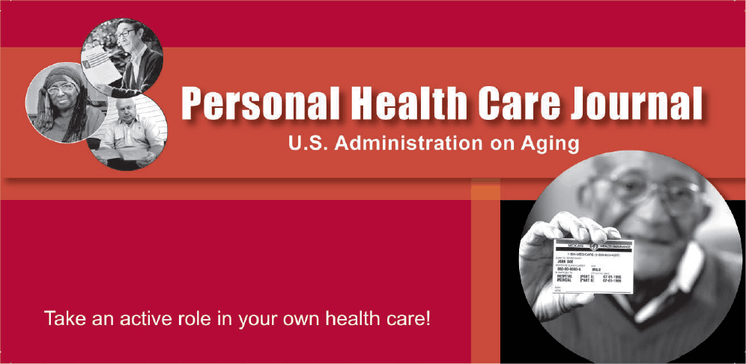
Step 2: Detect Medicare Fraud & Abuse, continued
Use your Personal Health Care Journal
Record doctor visits, tests, and procedures in this journal, and take it with you to your appointments.
Ask yourself questions about your health care. Write the answers and other information in your journal.
Compare your MSNs and other statements to your journal to make sure they are correct.
Notes:
Another way to help detect fraud, errors, and abuse is by using a calendar or a Personal Health Care Journal. (NOTE TO PRESENTER: Make them available to participants.)
Record doctor visits, tests, and procedures in your personal health care journal and/or calendar, and take your journal with you to all of your appointments.
Directions for using the Personal Health Care Journal are provided in the front of the journal and include a short list of questions you may want to ask yourself before your health care appointment. For example:
Is this appointment going to be covered by Medicare or my other insurance?
What are my symptoms? When did they start? What makes them better or worse?
What over-the-counter or prescription medications am I taking?
Write down the answer to these questions, as well as what happens during your visit, in your journal.
Later, compare your Medicare Summary Notices and other statements to your calendar or personal health care journal along with prescription drug receipts to make sure they are correct.
Suggested Handout: Personal Health Care Journal (For English, order through SHIBA’s fulfillment center. For other languages, order through: www.smpresource.org > Resources for SMPs > SMP Resource Library
Tip: If you have time, hand out the Personal Health Care Journal and review it with the group. Point out the instructions in the front of the PHCJ and explain how to use it to track health care visits and what types of questions to consider at each appointment.

Slide 25

Step 3: Report Suspected Medicare Fraud and Abuse
Call the provider.
Gather information and documentation.
Contact your SMP.
  This is a free and confidential service!
Notes:
Third, if you detect or suspect fraud or abuse, report it. You will protect other people from becoming victims and help to save your Medicare benefits. Here are the steps you should take to report your concerns:
First, if you have questions about information on your Medicare Summary Notice (known as your MSN) or Explanation of Benefits (called an EOB), call your provider or plan to find out if it was an error that they can correct without taking any further action.
If you are not satisfied with the response you get or are not comfortable calling your provider or plan, gather all of the facts that you can about your situation.
Make sure you have your MSN or EOB and any other supporting documentation that shows the possible fraud or abuse.
Then, contact your SMP if you need help.
Please keep in mind that services provided by your SMP are free and confidential.

Slide 26
Three Steps to Prevent Health Care Fraud
Protect
2) Detect
3) Report
Notes:
Remember how YOU can take charge and help prevent Medicare fraud, errors, and abuse in three easy steps: protect, detect, and report! And remember to take what you know and “pass it on” to friends and loved ones who might not be as familiar with this information.

Slide 27




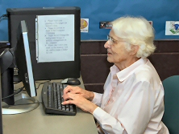
SMP Volunteers
Help Medicare beneficiaries protect, detect, and report
Give presentations (like this one!)
Provide one-on-one counseling
Perform administrative work
Join the SMP program as a volunteer!
Notes:
Now that you have learned how to prevent, detect, and report Medicare fraud, errors, and abuse, would you like to help other Medicare beneficiaries do so too? SMP volunteers, like ME, give group presentations like this one, provide individual counseling to beneficiaries, perform administrative work, and more! If you would like to join the SMP program as a volunteer, please talk with me after this presentation or contact the local SMP.

Slide 28
Contact your State SMP:
SHIBA
Visit us online: www.insurance.wa.gov
For more information
Call toll-free: 1-800-562-6900
To report suspected fraud/abuse
For training, speakers, and/or materials
To volunteer with the SMP program

Slide 29

Questions?
Notes:
If any of you have questions, please ask them now or feel free to talk to me after the presentation.
Answer questions or have your partner agency answer questions, as applicable; see the SMP Group Education Training Manual and/or SMP Counselor Training Manual for guidance during the Q&A session.
I hope today’s presentation has been useful in showing you how to take action to prevent Medicare fraud and abuse by taking three important steps.
Protect your Medicare number,
Detect fraud, errors, and abuse by reviewing your Medicare Summary Notices, and
Report any potential issues to your SMP.
Thank you for your time and for participating in this session!

