Slide 1
Statewide Health Insurance Benefits Advisors Basic Training
Updated May 2024
Notes:
Make sure date is for most recent updates

Slide 2
Welcome to the Statewide Health Insurance Benefits Advisors (SHIBA) basic training!
As a part of introductions, please share what you would like to learn during this training.
What questions would you like to have answered?
A few notes:
Your trainer may adjust the following slides depending on your level of experience and/or if this is a one- or two-day training.
The electronic version of this training includes notes for many slides and is posted on My SHIBA. Ask your trainer for more information.

Slide 3
Basic Training table of contents
Slide # | Content
1-4 | Welcome, introductions and acronyms
5 | Goals
6-8 | SHIBA advisor orientation
9-16 | Medicare introduction
17-28 | Enrollment and enrollment periods
29-43 | Original Medicare: Parts A and B
44-54 | Medicare prescription drug coverage: Part D
55-70 | Medigaps
71-83 | Medicare Advantage plans: Part C
84-93 | Low-income assistance programs
94-101 | Training tools and wrap-up
Notes:
Make sure this matches slides if making changes

Slide 4
Medicare training acronyms
Here’s a list of acronyms used in this presentation:
ESRD End Stage Renal Disease
GEP General Enrollment Period
HMO Health Maintenance Organization
IEP Initial Enrollment Period
LIS Low Income Subsidy (Extra Help)
LPR Legal Permanent Resident
MA Medicare Advantage (Part C)
MAPD Medicare Advantage Plans
with Prescription Drug Coverage
MIPPA Medicare Improvements for Patients and Providers Act
MSP Medicare Savings Program
OEP Open Enrollment Period
OIC Office of the Insurance Commissioner
OM Original Medicare (Parts A & B)
OTC Over-the-counter
PDP Prescription Drug Plan
PFFS Private Fee-for-Service
PPO Preferred Provider Organization
RTC Regional Training Consultant
SEP Special Enrollment Period
SHIBA Statewide Health Insurance Benefits Advisors
SHIP State Health Insurance Assistance Program
SMP Senior Medicare Patrol
SNP Special Needs Plans
SSA Social Security Administration
STARS SHIP Tracking and Reporting System
SSDI Social Security Disability Insurance
VC Volunteer Coordinator
A more detailed list is included with your training materials. Training acronym lists are also available by searching “acronym” on My SHIBA at www.insurance.wa.gov/my-shiba.

Slide 5
Goals for this training
Provide you with a broad high-level overview about:
SHIBA
Medicare
Senior Medicare Patrol (SMP)
Ensure you’re a confident candidate and have the basic training you need to move on to the SHIBA Path to Certification. The SHIBA Path includes the steps you’ll complete before you start advising clients on your own.

Slide 6
SHIBA advisor orientation

Slide 7
SHIBA and our mission statement
SHIBA is the Statewide Health Insurance Benefits Advisors and we’re part of the Washington state Office of the Insurance Commissioner.
SHIBA’s Mission
SHIBA provides free, unbiased information about health care coverage and access to help improve the lives of all Washington residents.
We cultivate community commitment through partnership, service and volunteering.

Slide 8
SHIBA history
The first State Health Insurance Assistance Program (SHIP) began in our state in 1979.
All states have a SHIP program.
SHIBA is funded by the federal government.
In Washington state, we are also funded by the state legislature.

Slide 9
Medicare introduction

Slide 10
Medicare 101
Medicare is our country's health insurance program for people aged 65 or older, and certain people under age 65 with disabilities. The program helps with the cost of health care but it doesn‘t cover all medical expenses or the cost of most long-term care.
Clients have choices for how they get Medicare coverage. If they choose to have Original Medicare (OM) coverage, they can buy a Medicare supplement policy (Medigap) from a private insurance company to cover some of the costs that Medicare does not.
Continued on next slide

Slide 11
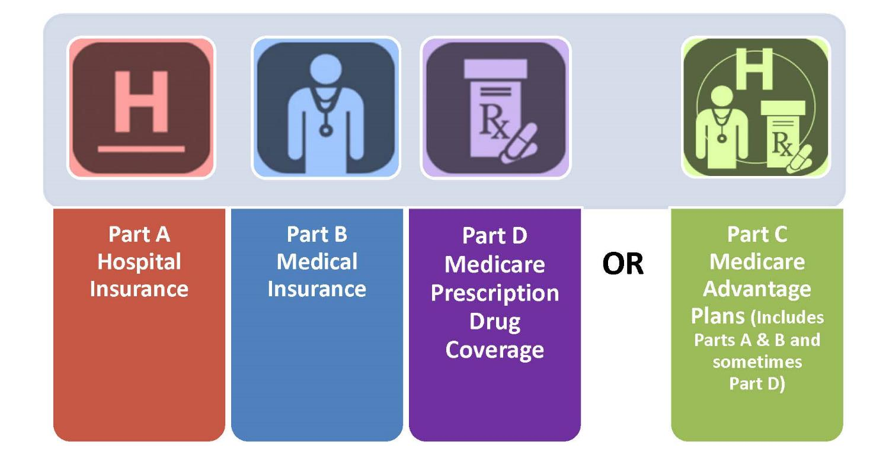
The four parts of Medicare

Slide 12
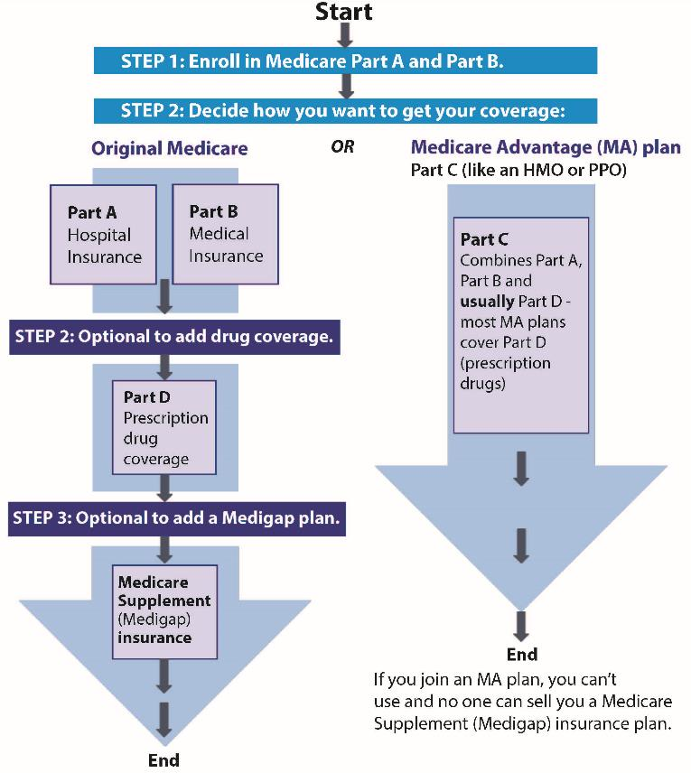
Medicare 101 (continued)
Medicare clients have options.
We’ll start by covering the basics of each part of Medicare and later we’ll look more closely at the coverage options shown at the right.

Slide 13
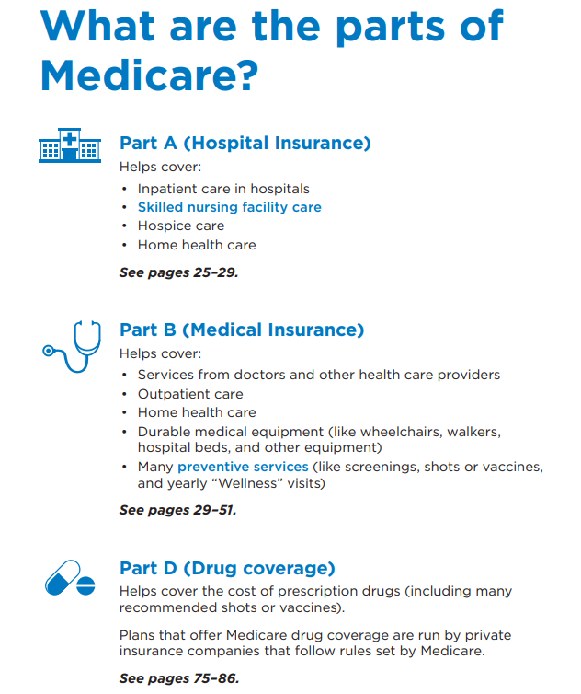
Medicare Parts A, B and D

Slide 14
Who is eligible for Medicare?
Age 65 and older.
Under age 65 and deemed disabled (Social Security Disability Insurance) by the Social Security Administration (SSA).
24-month waiting period
No waiting period if diagnosed with ESRD or ALS
Note: Must be a US citizen or legal permanent resident (LPR). If a client is an LPR, they must reside in the U.S. for 5 continuous years.

Slide 15
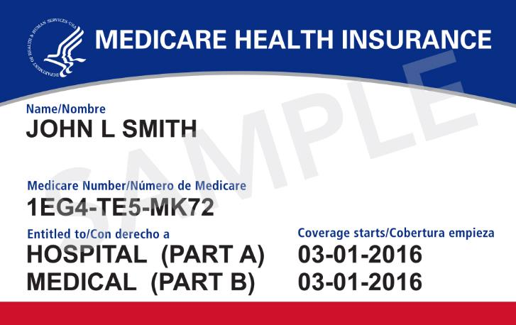
Medicare card
Are clients using the new Medicare card that came out in 2018? Tell them to guard their card. Help prevent fraud!
https://www.facebook.com/medicare/videos/guard-your-medicare-card/930570750674196/

Slide 16
Knowledge Check 1 – Intro to Medicare
1. What are the four parts of Medicare?
2. Who is eligible for Medicare?
What are the residency requirements to be eligible
for Medicare?
Notes:
Answers:
1. A, B, C, and D
2. Age 65 and older or Under age 65 and deemed disabled (Social Security Disability Insurance) by the Social Security Administration
3. US citizen or LPR living in US for 5 continuous years

Slide 17
Enrollment and enrollment periods

Slide 18
Some people are automatically enrolled
Automatic enrollment for people who turn 65 and receive:
Social Security benefits and/or
Railroad Retirement Board benefits
Automatic enrollment also occurs for people:
Under age 65 who apply to SSA for SSDI disability benefits (SSDI is Social Security Disability Insurance). Most of those with SSDI must have received it for 24 months.
Will receive an enrollment packet, including a Medicare card in the mail.

Slide 19
When enrollment is NOT automatic
If client is not receiving Social Security Administration (SSA) retirement income
They will need to enroll with Social Security:
Online at www.ssa.gov
Call 1-800-772-1213
Field Office Address locator: https://www.ssa.gov/locator/
If a client has questions about enrollment, have them contact Social Security at www.ssa.gov.

Slide 20
Three main Medicare enrollment periods
Initial Enrollment Period (IEP)
Special Enrollment Period (SEP)
General Enrollment Period (GEP)

Slide 21
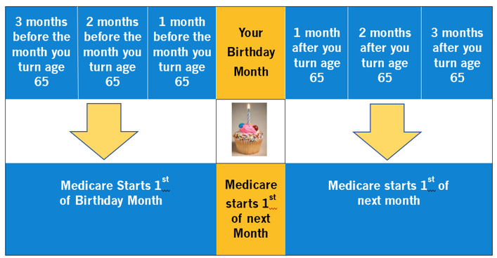
Initial Enrollment Period (continued)

Slide 22
Initial Enrollment Period
When the client is first eligible to sign up for Medicare, the IEP is the 7-month window they have to sign up.
Starts 3 months before client’s 65th birthday
Includes the client’s birthday month
Ends 3 months after client turns 65
Continued on next slide

Slide 23
Examples of Initial Enrollment Period
George will turn 65 in May. He enrolled in Medicare in February, and it will start on May 1.
Sally turned 65 in May as well, but she did not enroll in Medicare until August. Sally faces no penalty, and her Medicare will start September 1.

Slide 24
Special Enrollment Period
Special Enrollment Period (lasts 8 months)
Occurs after the Initial Enrollment Period (IEP) ends.
For people covered by a group health insurance plan based upon current employment.
Their own, a spouse’s or if disabled, then a family member’s.
Can enroll in Medicare Part A and/or B.
Any time still covered by the group plan.
During the eight-month period that starts the month after employment ends or the coverage ends, whichever happens first.

Slide 25
Example of Special Enrollment Period
Alec’s been working for a large employer and is getting ready to retire this year. He is 68 years old and has not signed up to collect Social Security or Medicare.
Alec can sign up for Medicare at any time now, using his Special Enrollment Period (SEP). His SEP will end when he has been retired for 8 months.

Slide 26
General Enrollment Period
General Enrollment Period (GEP)
If client missed Initial Enrollment Period.
If client missed or is not eligible for a Special Enrollment period (i.e., employer coverage).
Can enroll during the GEP.
January 1 – March 31 each year.
Coverage starts the month following sign up.
Premium penalties for Medicare Part A and/or Part B due to late enrollment possible.

Slide 27
Example of General Enrollment Period
Charlie is 68 years old. He stopped working over a year ago, and his employer doesn’t offer any retiree health coverage. He plans to sign up for Social Security when he turns 70 to get his maximum benefit. Since he is quite healthy, he thought he would wait until then to enroll in Medicare. Now he needs knee surgery!
He is past his Initial Enrollment Period, and it’s been more than 8 months since he was covered by active employer insurance, so he is past his Special Enrollment period.
Charlie will have to wait for the General Enrollment Period to enroll in Medicare.

Slide 28
Knowledge Check 2 – Enrollment
The 7-month period when first starting Medicare is called…
A client can delay Part B enrollment if they are covered by a group health insurance plan based on current employment.
Notes:
Answers:
Initial Enrollment Period (IEP)
True

Slide 29
Original Medicare
Parts A and B are referred to as Original Medicare (OM)

Slide 30
Original Medicare: Parts A and B

Slide 31
Original Medicare – Part A
Part A – Hospital insurance:
Inpatient hospital
Skilled nursing facility (limited)
Home health care
Hospice care
Blood

Slide 32
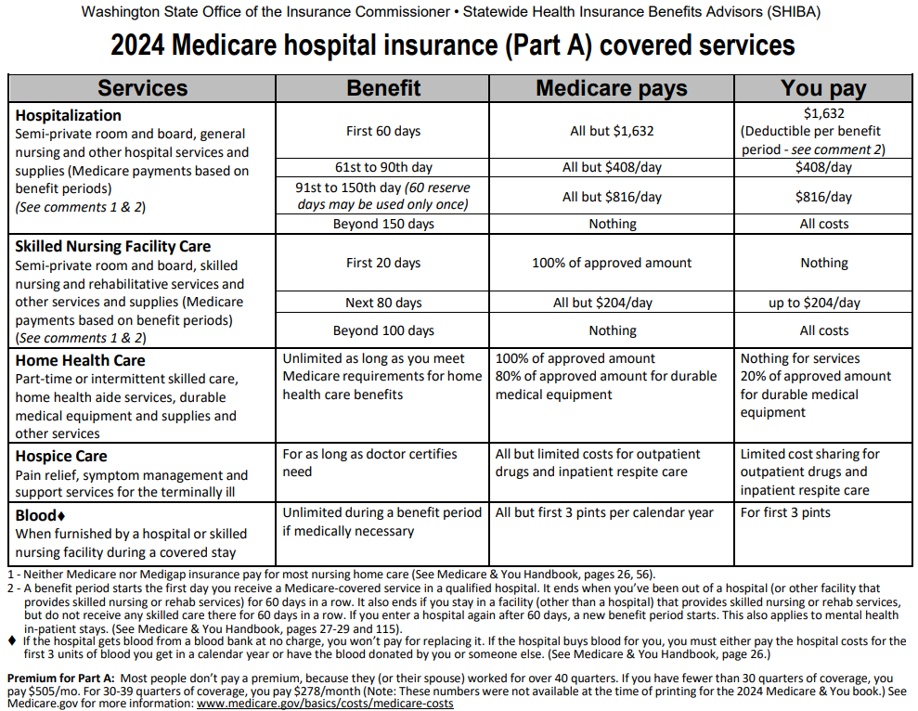
Medicare hospital insurance (Part A)
Link here!
Notes:
Make sure link and chart are updated

Slide 33
Medicare Part A (hospital insurance)
What does Part A cost in 2024?
Most people get Part A premium-free
They or their spouse must have paid FICA taxes for at least 10 years (40 quarters)
IF they paid into Medicare less than 10 years, they:
Can pay a premium to get Part A
$505 per month (if worked fewer than 30 quarters)
$278 per month (if worked 30 -39
quarters)
See the bottom of your Medicare Part A chart.
Notes:
Make sure link and slide info are updated

Slide 34
Examples of Medicare Part A
Evelyn is a widow and has contributed to Medicare for the last 20 years through her job. She’s earned 40 working quarters throughout her active work. When Evelyn enrolls in part A, it’ll be premium-free.
Vivian is single and has acquired only 35 quarters for Medicare, therefore she doesn’t qualify for premium-free Part A. Vivian will have to pay a monthly premium of $278 (in 2024) to receive Part A. Vivian can also continue to earn more quarters.
Notes:
Make sure $ and date are updated

Slide 35
Original Medicare – Part B
Part B – Medical insurance:
Doctor visits
Outpatient hospital services
Tests, labs, x-rays, etc.
Durable medical equipment (DME) and supplies
Preventive services

Slide 36
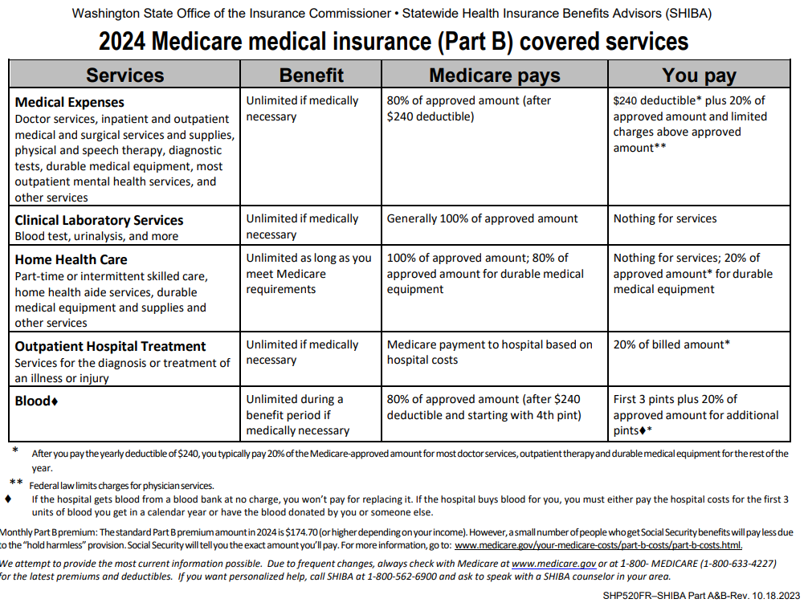
Medicare medical insurance (Part B)
Link here!
Notes:
Make sure link and chart are updated

Slide 37
Medicare Part B (medical insurance)
What does Part B cost?
In 2024, most people will pay $174.70 per month
People with higher incomes could pay more
Social Security will notify clients if they have to pay more or less than the standard premium
The amount may change depending on the client’s yearly income
Notes:
Make sure $ and date are updated

Slide 38
Examples of Medicare Part B
William enrolled in Medicare in 2013. His Part B premium in 2024 is $174.70.
Natasha’s Medicare started in 2018. Her income is $105,326.02 per year. Her Part B premium in 2024 is $244.60.
New Medicare premiums are announced each fall for the next calendar year. Social Security notifies individual enrollees of their premium. Factors affecting the amount include:
Current income (higher or lower may pay more or less)
If there’s a cost-of-living adjustment to people’s Social Security benefit in the new year
Notes:
Make sure date and $ are updated

Slide 39
Does a client need Part B?
It depends. Potentially no, if:
They have coverage through active employment.
Their own job, their spouse’s job, or if disabled and under 65, then another family member’s job.
Things to consider:
Some of the decision is based upon rules about when Medicare would pay BEFORE the employer plan pays.
People should check with their employer, in some cases, small employers will pay AFTER Medicare pays, even with active employment.
Delaying Part B may mean:
Higher premiums (late enrollment penalty)
Waiting for GEP
Paying for their health care out-of-pocket

Slide 40
Examples of Part B coverage considerations
Maggie plans to keep working until she’s 68. She’s covered by her employer’s insurance. Maggie will sign up for Part A but defer Part B until she stops actively working.
Barbara retired at age 63 and has been paying for a private insurance plan. At age 65, she will start her Medicare Parts A and B.

Slide 41
Paying for Medicare Parts A and B
In addition to Part B premiums (and sometimes Part A), client pays:
Part A hospital deductible
Part B yearly deductible
20% coinsurance for most services
May be other costs

Slide 42
Example: Coverage for “medically necessary”
Sara is diagnosed with glaucoma. Medicare does not cover eye exams related to prescribing glasses (with the exception it does cover eyeglasses after cataract surgery).
Medicare does consider covering regularly scheduled eye exams to monitor Sara’s eye health as “medically necessary.”
Medically necessary
Health care services or supplies needed to diagnose or treat an illness, injury, condition, disease or its symptoms and that meet accepted standards of medicine.
Notes:
Trainers: This could be an opportunity to discuss the term “medically necessary.”

Slide 43
Knowledge Check 3 – Parts of Medicare
1. What parts of Medicare are known as Original Medicare?
2. Part B covers…
Notes:
Answers:
A & B
Out-patient, general medical care, and Durable Medical Equipment (DME)

Slide 44
Medicare prescription drug coverage
Also called Part D

Slide 45
Medicare Part D

Slide 46
Medicare Part D
Medicare prescription drug coverage (Part D) helps clients pay for both brand-name and generic drugs. Drug plans are offered by insurance companies and other private companies approved by Medicare.
Available to all people with Medicare Parts A and/or B.
Provided through:
Stand-alone Part D plans (PDP)
Medicare Advantage Plans (MAPD)

Slide 47
Who can enroll in Part D?
Clients must:
Have Medicare Part A or Part B or both.
Live inside the U.S. and can’t be incarcerated.
Enrollment is not automatic for most.

Slide 48
Do all clients need Part D?
It depends…
Do they already have creditable drug coverage from another source?
Creditable means it’s as good as Medicare Part D.
For example, through an employer plan
Without creditable coverage, client may have:
To wait to enroll
A penalty

Slide 49
What Part D covers
Prescription brand-name and generic drugs only.
Each plan has its own formulary (a list of covered prescription drugs, also called a drug list).
Plans must cover a range of drugs in each category.
Coverage and rules vary by plan.
Note: Part D does not cover over-the-counter drugs.

Slide 50
Examples of Part D plan coverage
Bob was told by his doctor to take a low-dose aspirin daily. Since this is an over-the-counter (OTC) medication, Part D plans do not cover it.
Samantha takes several brand-name and generic prescriptions. The Plan Finder will help her see if there’s a plan that will cover these and if there are any coverage rules, such as:
Quantity limits
Prior authorization
Step-therapy

Slide 51
Medicare drug plan costs
What do clients pay?
Cost varies by plan.
Most people pay:
A monthly premium
A yearly deductible
Copayments or coinsurance
Amounts vary over the course of the year based on cost of drugs.

Slide 52
When can clients enroll in Part D?
During 7-month Medicare Initial Enrollment Period (IEP).
During Open Enrollment Period (OEP).
October 15 – December 7
Coverage starts January 1
Can possibly join at other times.
Special Enrollment Period (SEP)
Examples: Move to a new area, gain or lose employer or retiree coverage, are eligible for Extra Help/Low Income Subsidy (LIS)

Slide 53
How do clients choose a Part D plan?
Call SHIBA for help at 1-800-562-6900.
Research the online Plan Finder at: https://www.medicare.gov.
Contact the plan to find out if their medications are on the plan formularies and ask about costs.
Additional training is offered to SHIBA volunteers in this area – it’s the best way for clients to compare plans.

Slide 54
Knowledge Check 4 – Part D
What does part D cover?
When can a client enroll in Part D?
Notes:
Answers:
Prescription drugs
IEP, OEP, SEP

Slide 55
Medigaps
Also called Medicare Supplement plans

Slide 56
Medigap (Medicare Supplement)

Slide 57
What is a Medigap plan?
Medigaps (also called Medicare Supplement plans) are sold by private insurance companies.
They help pay for “gaps” in Original Medicare.
Gaps include:
Deductibles, coinsurance and copayments
Medigaps are standardized and designated by letters A-N.

Slide 58
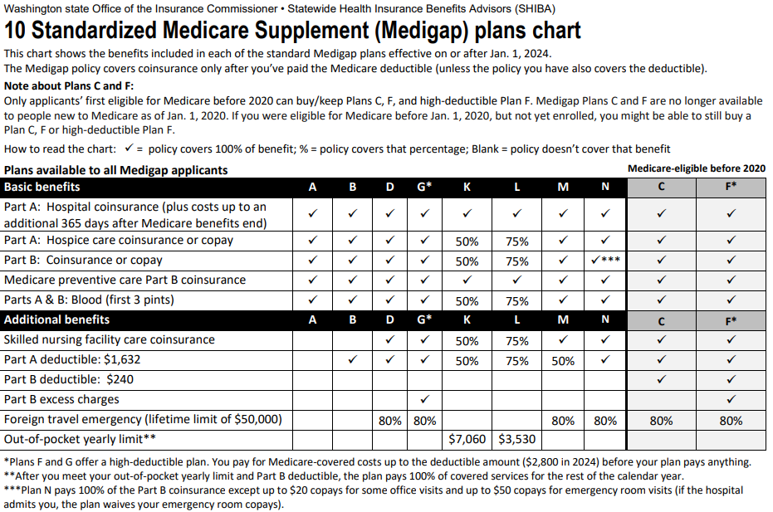
How to compare Medigap plans
Link here!
Notes:
Make sure link and chart are updated

Slide 59
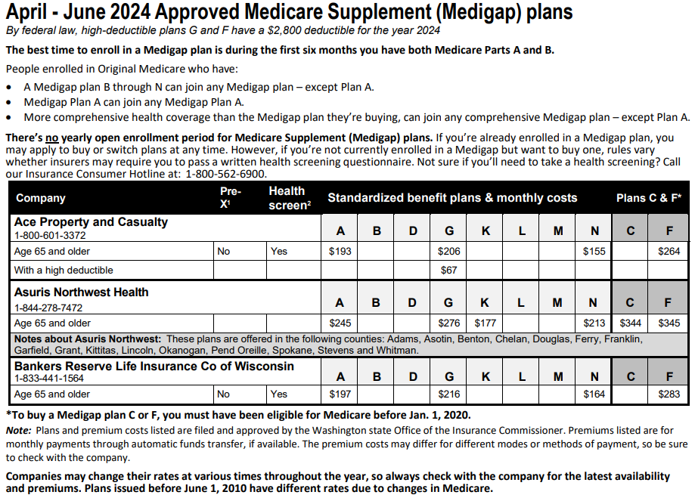
Approved Medigap plans and rates
Link here!
Notes:
Make sure link and chart are updated

Slide 60
Example of Medigap plan
Willem has Original Medicare Parts A and B and a Medigap plan. As long as Willem’s doctor accepts Medicare and Medicare Parts A and B cover the care he gets, his Medigap will pay its part after Medicare pays. Then, if there’s anything left over, Willem will be billed for the remaining.
Medicare coordinates its payments with most Medigap plans, so the doctor or Willem most likely will not have to take any other action to get the Medigap to pay.

Slide 61
Who is eligible for a Medigap?
Any client with Original Medicare Parts A and B.
Medicare clients under age 65 have limited choices.
There are no “guaranteed issue” protections for people under age 65 in Washington state.

Slide 62
Do clients need a Medigap?
If a client is NOT covered under an employer plan (active or retired) and does not have any other source to pay for the balances after Original Medicare has paid, they may want to consider a Medigap.

Slide 63
When to enroll in a Medigap
Clients may enroll in a Medigap any time after they enroll in Medicare Parts A & B if a company agrees to sell them one.
Medigaps don’t have an annual Open Enrollment Period (OEP).
Each individual gets their own one-time six-month OEP (see next slide).

Slide 64
When to enroll in a Medigap
Clients are guaranteed to get a Medigap without a written health screening:
During the six-month period that starts the first day of the month that they’re 65 or older AND enrolled in Part B. Medicare calls this the “Medigap Open Enrollment Period.”
If they currently have a Medigap plan B through N, they can join any Medigap plan – except Plan A.
If they currently have Medigap Plan A they can join any Medigap Plan A.

Slide 65
Examples of Medigap OEP
Toby is 69 years old and just enrolled in Medicare Part B. Toby is retiring from his job, therefore he is going to use his Special Enrollment Period. His six-month Medigap Open Enrollment Period starts as soon as his Medicare Part B starts.
Samantha is 63 years old, disabled and on SSDI. She was automatically enrolled in Medicare Parts A and B because she has been on SSDI for 24 months. Her six-month Medigap Open Enrollment Period will not start until the month she turns 65.

Slide 66
Examples of Medigap enrollment rules
Lin bought a G plan with Pear Company. Lin now wants an N plan that Pear Company provides. She can call Pear Company and buy the N plan to replace her G plan.
Lee bought a G plan with Pear Company but wants a G plan from Grape Company. He can call the Grape Company and enroll. Once his new plan activates, it is his responsibility to cancel with Pear Company.

Slide 67
Things to consider about Medigaps
Medigaps are good nationwide.
A client should make sure the providers they use will accept patients with Original Medicare.
Once a client buys a Medigap, it’s theirs as long as they pay the premium.
There is portability in Medigaps.
Plans C & F are only available to people who were eligible for Medicare prior to Jan. 1, 2020.
Continued on next slide

Slide 68
Things to consider about Medigaps (continued)
Insurance companies can only sell the client a “standardized” plan (letters A – N).
Medicare standardizes Medigaps:
Plans with the same letter designation all cover the same benefits.
Different insurance companies may charge different premiums for the exact same plan.
Medigaps sold today DO NOT pay for prescription drugs.
Most should consider buying a drug plan (Part D)

Slide 69
How to find the right Medigap plan
Clients can call SHIBA for help at 1-800-562-6900.
Research what benefits each plan letter provides.
Compare the plan costs to what is affordable to the client.

Slide 70
Knowledge Check 5 - Medigaps
1. Which part(s) of Medicare do Medigaps (Medicare Supplement Plans) help cover?
2. When can a client enroll in a Medigap?
Notes:
Answers:
A & B
Anytime, but they may be denied without a guarantee, the first 6 months of having both Part A & Part B, if they are eligible for a guaranteed issue for a special situation

Slide 71
Medicare Advantage (MA) plans
Also called Medicare Health Plans or Part C

Slide 72
Medicare Advantage

Slide 73
Medicare Advantage (Part C)
Medicare Part C (Medicare Advantage) is another way to get Medicare coverage.
Plans are sold by private insurance companies.
Most plans require clients use a defined provider network.
Clients can get a coverage determination from the plan before they get a service to find out if it’s covered and get an estimate of costs.
Choice of plans varies depending on what county the client lives in.

Slide 74
How Medicare Advantage (MA) plans work
Provides all the same rights and protections as Original Medicare.
Delivers Part A and B benefits, but rules can vary.
Generally, must use network providers for best coverage.
Medicare pays a private plan to provide the services.
Client pays Part B premium and may also pay plan premium.
An annual maximum out-of-pocket limit can protect clients from catastrophic health costs.
Most include Part D prescription drug coverage.
May include extra benefits:
Vision, dental, hearing and health club memberships.

Slide 75
Who is eligible?
Anyone enrolled in Original Medicare Parts A and B and lives in the plan’s service area.

Slide 76
When can clients enroll in an MA plan?
Medicare Initial Enrollment Period (IEP).
Special Enrollment Period (SEP):
Examples: move to a new area, gain or lose employer or retiree coverage, are eligible for Extra Help/Low Income Subsidy (LIS).
Open Enrollment Periods (OEP):
Annual OEP Oct. 15 – Dec. 7 (coverage starts Jan. 1)
Medicare Advantage OEP Jan. 1 – Mar. 31
Depending on what county the client lives in,
MA plans may not be available.

Slide 77
Examples of Medicare Advantage plan
Sally checked with her doctor’s office about Medicare, and they told her they only accept three Medicare Advantage (MA) plans. They gave her the list. They do not accept Original Medicare. Sally wants to continue to see her doctor when her Medicare starts, so she will choose one of these MA plans.
Bob checked with his doctor’s office about Medicare, and they told him that they only accept Original Medicare. They do not accept any MA plans. Bob wants to continue to see his doctor when his Medicare starts, so he will not enroll in an MA plan.

Slide 78
Example of Medicare Advantage plan
Morgan is 57 years old and is on Medicare because he’s disabled. He has a lot of health problems and is not able to buy a Medigap plan. Choosing an MA plan can help protect him from catastrophic health care costs.

Slide 79
What are Medicare Advantage plan costs?
Medicare pays a fixed monthly payment to the private plan for the client’s care. Clients pay:
Part A premium (if any)
Part B premium
MA plan’s monthly premium (if any)
Copays
Coinsurance
Deductible
Non-covered services – (not calculated in maximum out-of-pocket)
Note: “Maximum out-of-pocket” limits costs of covered care to enrollee.

Slide 80
Four most common types of MA plans
Health Maintenance Organization (HMO) plans
Preferred Provider Organization (PPO) plans
Special Needs Plans (SNPs)
Private Fee-for-Service (PFFS) plans. In 2024, there are no PFFs plans in WA state
Notes:
Make sure date is updated

Slide 81
Things to consider about MA plans
Medicare Advantage (MA) plans offer comprehensive coverage (including Part D coverage).
May require a referral to see a specialist.
Does not work with Medigap plans.
Not all providers are included in the MA’s network.
MA plans require clients to pay some of the cost.

Slide 82
Shopping for MA plans
Look at BOTH the health benefits and drug benefits of each plan separately.
Clients can do this on the medicare.gov website (SHIBA volunteers may assist with this).
Look at MA plans’ websites for summary of benefits and provider lists.
Always verify provider participation by contacting the provider.

Slide 83
Where do clients enroll?
Call: SHIBA at 1-800-562-6900
Call: 1-800-633-4227 (1-800-MEDICARE)
Call the plan
Online at www.medicare.gov
Contact a licensed agent

Slide 84
Low-Income Assistance
Medicaid & Medicare Savings Program (MSP)
Social Security Extra Help

Slide 85
LIS/Extra Help automatic enrollment
All beneficiaries enrolled in Medicaid and MSP programs are automatically enrolled in LIS/Extra Help.
No separate application for LIS is needed.

Slide 86
What is a Medicare Savings Program?
Medicare Savings Programs (MSPs) are state programs that assist with paying Medicare costs.
These are assistance programs, not insurance plans.

Slide 87
Qualified Medicare Beneficiary (QMB)
QMB pays for Part A and B:
Premiums
Deductibles
Co-pays
Co-insurance
Clients must be at or under 110% of the Federal Poverty Level (FPL).
Notes:
Make sure % is updated

Slide 88
Specified Low-income Medicare Beneficiary (SLMB)
SLMB pays for Part B premium.
Client’s income must be at or under 120% FPL.
Notes:
Make sure % is updated

Slide 89
Qualified Individual (QI-1)
QI-1 pays for Part B premium.
Client’s income must be at or under 138% FPL.
Notes:
Make sure % is updated

Slide 90
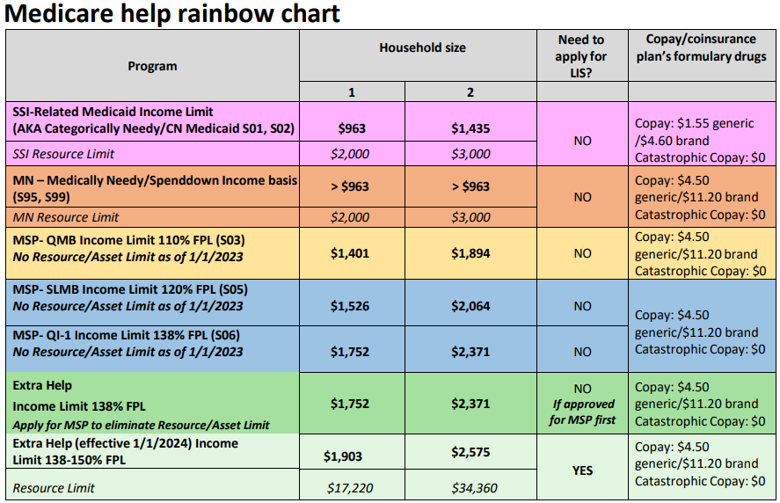
Rainbow Chart
Link here!
Notes:
Make sure link and chart are updated

Slide 91
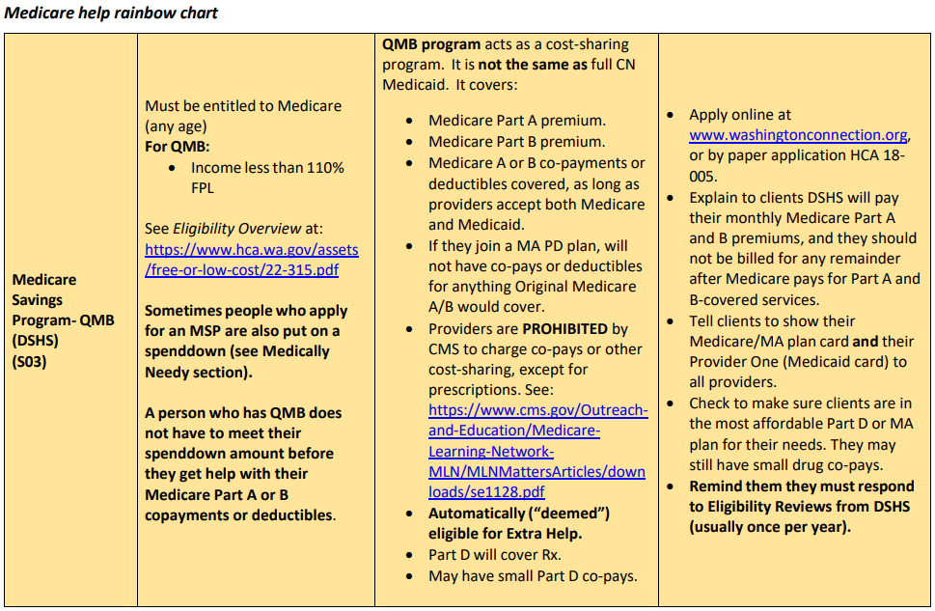
Rainbow Chart page
Notes:
Make sure link and chart are updated

Slide 92
Help paying for Part D
“Extra Help” or “Low-income-subsidy” (LIS) is a program available to clients with limited income and resources.
Extra Help or LIS will pay for all or part of premiums, deductible and copay for eligible clients.
Part D penalties are waived for LIS clients.
LIS enrollees can change plans during the first three quarters for the current year and during the OEP for the following year.
Find LIS applications at: www.ssa.gov.

Slide 93
Example of help paying Part D premium
Samantha receives $1,400 per month in Social Security retirement. She has less than $10,000 in savings. Extra Help could save her a lot of money. The program:
Could help pay some or all of her Part D premium.
Pay most or all of her deductible.
Make it so she has small drug copays.
Could allow her to change her drug plans more than once per year.

Slide 94
Training tools and wrap-up

Slide 95
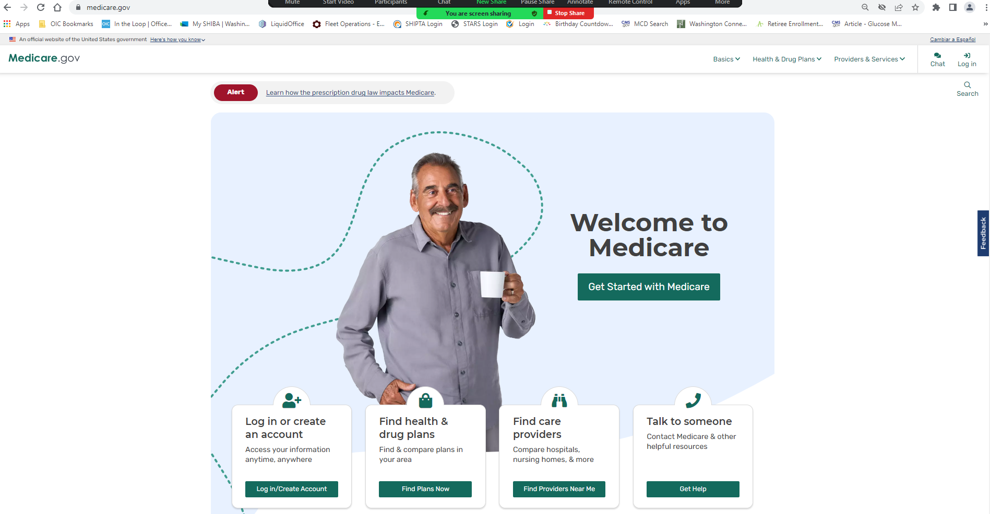
Medicare.gov
Medicare.gov

Slide 96
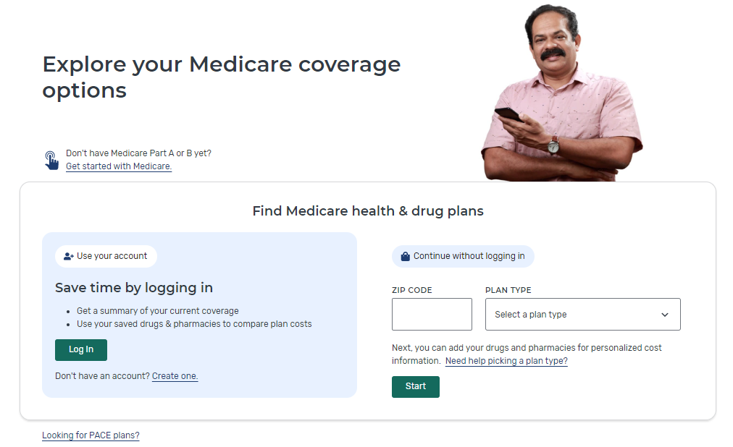
Plan Finder
Medicare Plan Finder (medicare.gov)

Slide 97
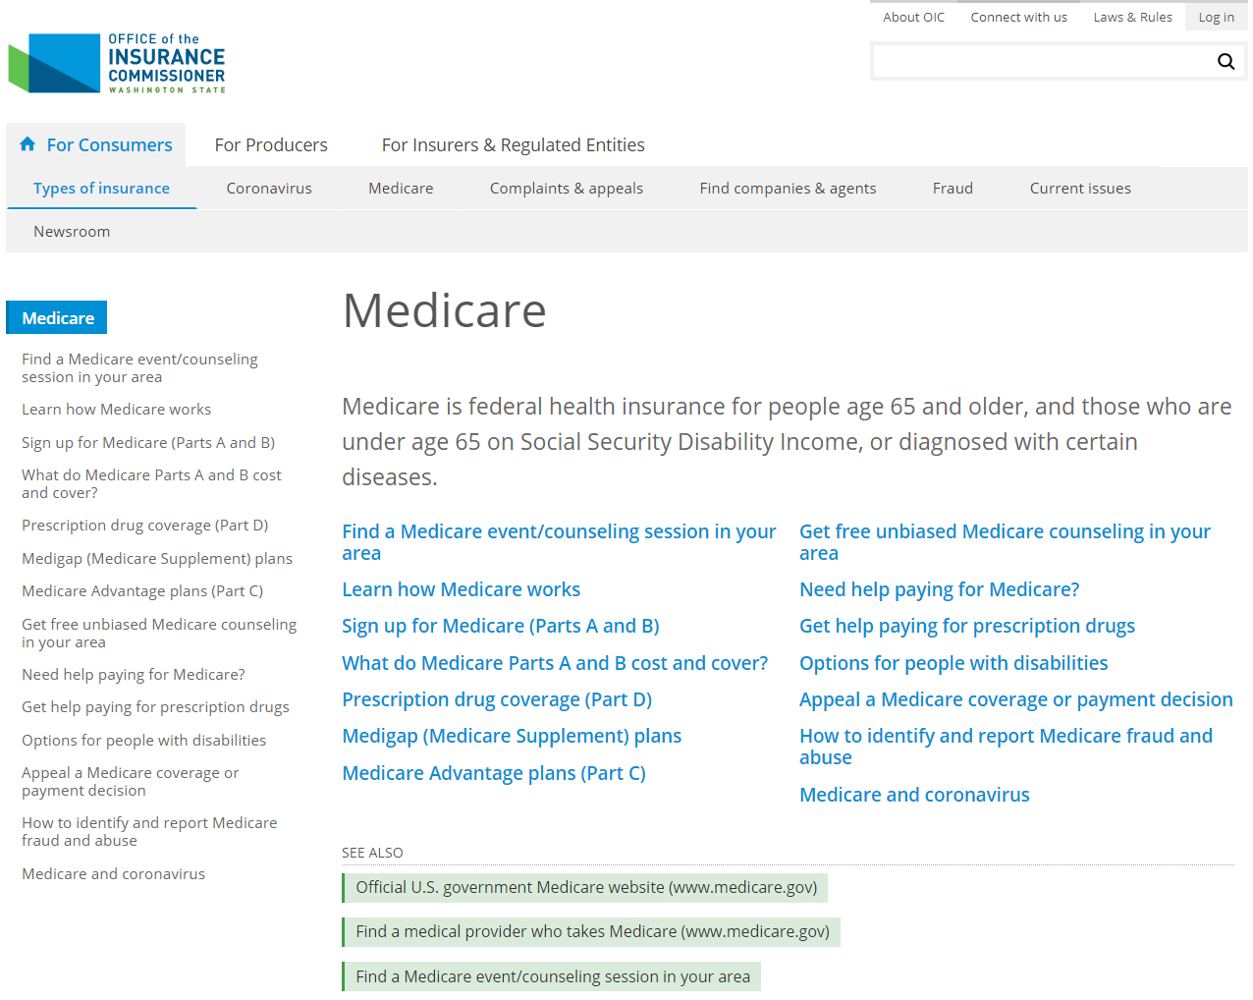
Office of the Insurance Commissioner
OIC (insurance.wa.gov)
Be familiar with the Medicare pages on the OIC website and share this information with clients.

Slide 98
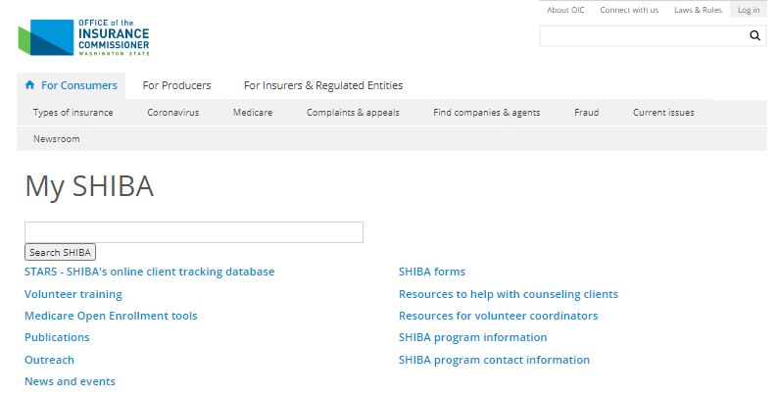
My SHIBA (continued)
My SHIBA (insurance.wa.gov)
The home page for My SHIBA includes links to a variety of information that you’ll need for your work.

Slide 99
Referrals and providing more insurance help
You can also help your clients by letting them know about the OIC’s statewide toll-free Insurance Consumer Hotline at: 1-800-562-6900.
The Consumer Hotline is a free service where clients can get help with all types of insurance, such as home, auto, health, life, disability coverage, long-term care and even annuities.
Clients can also find more information at: https://www.insurance.wa.gov

Slide 100
Final thoughts and questions
What questions do you have?
Did we answer your questions from the start of training?
Where do you hope or plan to go from here?
What can we do to help?
Contact SHIBA:
shiba@oic.wa.gov 1-800-562-6900
www.insurance.wa.gov/my-shiba

