Slide 1
Medicare Plan Finder 101:
Tips and Tricks for Navigating the Plan Finder
Adapted from ACL Presentation to SHIPS 7/23/2018

Slide 2
Agenda
It’s about practice!
Beneficiary Preparation
Counselor Preparation
Plan Finder Walk Through
Enrolling
Reviewing Results for Beneficiaries
Plan Finder Help and FAQ
Reporting Issues with MPF
Resources

Slide 3
Using the Plan Finder takes Practice!
Go ahead and try it out
There are Plan Finder training videos posted on the Medicare.gov web site
SHIBA has practice Plan Finder worksheets you can use
Ask questions!
Regional Training Consultant
Volunteer Coordinator
Experienced volunteers
Staff in SHIBA Tumwater office

Slide 4
Beneficiary Preparation
It’s important to be prepared when meeting with a beneficiary because preparations will save you and the beneficiary time and reduce stress.
Provide the beneficiary with a list of items to have ready or to bring for their appointment, whether it is in person or by phone.
Notes:
It’s important to be prepared when meeting with a beneficiary because preparations will save you and the beneficiary time and reduce stress.
Provide the beneficiary with a list of items to have ready or to bring for their appointment, whether it is in person or by phone.

Slide 5
List of items from the Beneficiary
Medicare number and effective dates for Part A or Part B
Date of birth
Zip code
List of drugs that includes dosage & quantity
Name and address of their preferred pharmacy
Name of their current Medicare plan (if applicable)
Ask if they are currently receiving LIS/MSP or if they are dual eligible (Medicare & Medicaid)
If not, you can screen them to see if they are eligible.
Notes:
The beneficiary can bring the medication bottles to the office or they can provide the list over the phone
If the appointment is by phone, request the beneficiary to provide the prescription information as stated on the bottle.

Slide 6
Tips for the Counselor
Have the client contact form ready
Do a complete intake
Make sure to write down the Drug List ID number and Drug List ID password.
Use the personalized search on the Medicare Plan Finder (MPF)
The personalized search is specific to the beneficiary
The MPF will show if the beneficiary is dual eligible or LIS/MSP eligible
The plan finder will show the subsidy prices
If the personalized search doesn’t work, don’t panic. Do a general search using the information you have available.
Notes:
As a counselor, you can do the full intake with the beneficiary in-person or by phone. A complete intake is gathering information about the beneficiary that you would need to perform a plan comparison with the Medicare Plan Finder their name as it appears on the Medicare card, Medicare number, effective date for Medicare Part A or B and list of drugs. Additionally, get their address as well just in case you need to mail information to them. When beneficiaries request an appointment, go ahead and gather their information needed and have a comparison ready for them at their scheduled appointment. It’s very important to have a place designated on the form for the drug list ID number and password.
General Plan Finder: This will still provide good and useful information that the beneficiary can use in making a decision. If the personalized search isn’t working, use the general search as that will give you a good idea of the medication costs. The main difference is that it will not show you LIS levels.

Slide 7
Medicare.gov Home Page
Notes:
Points to cover: It’s helpful to collect information from the beneficiary. Info from their Medicare Card, Zip code, list of drugs (exactly as it appears on the RX bottle) and pharmacy information.
Two ways to go to the MPF
Top blue- “Sign Up/Change plans. Will have drop down box if you put your cursor over it or simply click on it and the page will show everything in the drop down box- Click on “Find health & drug plans”
Encourage volunteers to take time to review the remaining blue tabs and other information that they can access from www.meidcare.gov
Fastest way to Plan Finder is to click on the Green button that says “Find Health and Drug Plans” .

Slide 8
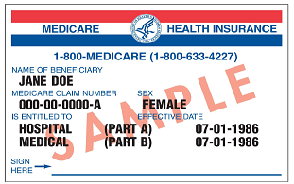
Plan Finder Search Options
Notes:
Points to cover:
Explain the difference between General Search and Personalized search.
General: will provide an estimated costs; find plans for your respective area; you can specify if you receive Original Medicare; MA/MA-PD; if you don’t have coverage yet or you don’t know and also specify if you receive assistance from Medicaid, SSI, MSP, LIS, don’t receive assistance, and if you’re not sure.
Personalized: this will provide you with a more accurate cost estimates based on your current plan and subsidy information. You will need beneficiary’s zip, MCR number, Last name (as it appears on Medicare Card), effective date for A and/or B, and date of birth.
It is crucial to enter the information exactly as it appears on Medicare card
If you don’t have Part A, you can click on the blue hyperlink and enter your part B effective date.
Instead of scrolling in drop down box- type in the first letter of the month and hit the down arrow until your selection appears.
NOTE: in the circled area on the right, you can do several useful things, most without having to go thru all of the Plan Finder steps; including:
Search by Plan Name and/or ID
Enroll now
Check current enrollment of a client

Slide 9
General Search Questions
Notes:
Points to cover:
When you do General Search, you must answer questions so PF knows how to price
Hover over questions, a box will pop up that explains which one to choose
Be sure to say “Yes” to the question, about adding drugs, if you plan to add any drugs

Slide 10
Prescription Pop Up Box
Notes:
Points to cover:
My current profile will appear on each page as you go through the plan finder.
Accuracy of drug name, entering the drug, quantity and dosage. (go to next screen to show the quantity & dosage pop up box)
After the first drug is entered, the drug list ID will appear and you will need to give a password date. You can leave date as is or create a new one. Stress the importance of saving the drug list ID, password date, & zip.
List of drugs entered will be noted below.

Slide 11
Prescription Pop Up Box
Notes:
Points to cover:
Include how the session will “time-out” after 30 minutes of inactivity
Select the correct dosage, quantity, frequency & pharmacy type.
Stress the importance of selecting the correct dosage
When you select “I get this medicine from a mail order pharmacy” the quantity will automatically default to “90” and frequency will automatically default to “every three months”

Slide 12
Generic Option
Notes:
Points to cover:
A pop-up box: re: brand name showing generic alternative.
Explain the difference between lower cost generic and brand name.
Explain if drug is not found- it is either drugs that are excluded from Medicare coverage or a compound drug.
Once all drugs are in your list, you can print it. Click My Drug List i

Slide 13
Adding Pharmacies
Notes:
Points to cover:
Review “my current profile” how it will appear with each step.
Explain how the pharmacy search/add works- select up to 2 pharmacies.
Use the “Search New Location or by Pharmacy Name” If you can’t find your pharmacy
Click on the “Show/Hide” pharmacy map to show the location. (i.e.- Pharmacy may be on the same street but it could be north broadway or south broadway) or if beneficiary gives you a pharmacy name but only provides the intersection that it is closest to.

Slide 14
Refining Plan Results
Notes:
Points to cover:
During OEP, the plan results will default to viewing 2018 plans. For people who are still shopping for 2017 plans, you can click to look at the current year.
Review the “number of plans” available
Touch base on “refine your search” options.
Note that if you want to see Special Needs Plans, must select the option on the “Refine your Search” side. If the SNP is for Dual-eligible, it won’t be viewable unless the search (either Personalized or General) shows the client HAS a Medicaid plan

Slide 15
Plan Results Page
Notes:
Points to cover:
Review the Symbols
Review the “Plan Results Page”
Review the three stars.

Slide 16
Your Plan Results
Notes:
Points to cover:
Shows the beneficiary’s current plan-.
Shows the number of plans available in the beneficiaries area
You can view 10 plans at a time or view all
Select up to three plans to compare side by side. Can select current, PDP, & MAPD to compare side by side.

Slide 17
Plan Comparison
Notes:
Points to cover:
Select up to three plans to compare side by side. Can select current, PDP, & MAPD to compare side by side.

Slide 18
Plan Comparison Side-by-Side
Notes:
Points to cover:
Review tabs. We will cover each tab in the next few slides
Review symbols & enrollment date reminder.
Plan results come up in columns, read from top down

Slide 19
Benefits at a Glance
Notes:
Points to Cover:
Can view benefits side by side.

Slide 20
Drug Costs & Coverage Tab - Fixed Costs
Notes:
Points to cover:
Review the Drug Cost & Coverage tab- Explain the “fixed costs”

Slide 21
Comparing Costs
Notes:
Points to cover:
Review the costs shown with each pharmacy listed
Costs includes premium and drug costs

Slide 22
Monthly Cost Estimator
Notes:
Points to cover:
Review Monthly Cost Estimator & explain the estimator showing “monthly cost chart for”. Clicking on this bar chart will display results in this format- see next slide.

Slide 23
Monthly Cost Estimator
Notes:
Points to cover:
Review Monthly Cost Estimator & explain the estimator showing “monthly cost chart for”. The Bar Chart gives a visual estimate of the month-by-month costs for each plan and what part of the cost is the Premium, Deductible, Co-pay/Co-Insurance, Coverage Gap (AKA Donut hole) and Catastrophic phase. Note the dollar amount at the top of each column will vary from plan to plan.
The red circle shows which pharmacy information you are looking at

Slide 24
Drug Coverage Information
Notes:
Points to cover:
Review of Drug coverage information and explain the “mail order” availability & the network pharmacies.

Slide 25
Pharmacy Type
Notes:
Points to cover:
Preferred, If your plan's network includes preferred cost sharing pharmacies, you may save money by using them. Your prescription drug costs (such as a copayment or coinsurance) may be less at a preferred cost sharing pharmacy because it has agreed with your plan to charge less on at least some drugs.
Standard Pricing A network pharmacy that offers covered drugs to plan members at higher out-of-pocket costs than what the member would pay at a preferred cost sharing pharmacy.or Out-of-Network
Opportunity to change pharmacy if a recommended pharmacy shows up as preferred

Slide 26
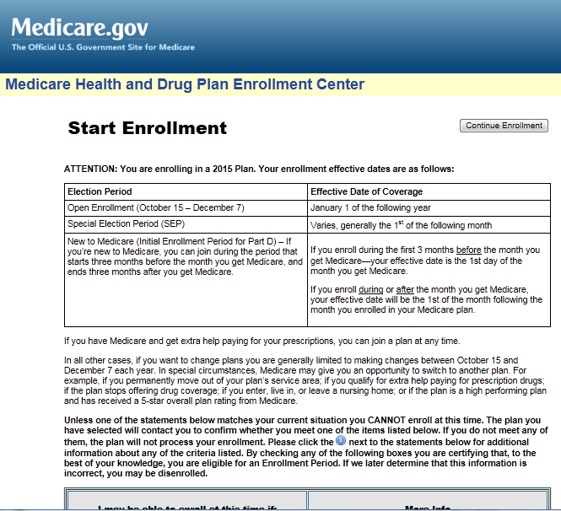
Enrolling into a plan
Notes:
If client enrolls this way VERY Important to print out the Enrollment Confirmation
If you can’t print it, at least write down and save the Enrollment Confirmation Number. If a number is shown, it means the enrollment went through.

Slide 27
Important note about results
Plans send updated pricing info to CMS regularly.
Pricing is “frozen” in the Plan Finder during the month of September each year.
Plan Finder pricing results are an estimate and prices can change during the year.
It is still helpful as a basis of comparison and clients will learn:
If their current drugs are on the formulary and any restrictions
What tier level they are placed at by each plan
Notes:
Updating wording on our Plan Finder Results letter to note the costs are an ESTIMATE.

Slide 28
What to focus on for results
COST: January or rest-of-year costs
Includes Premium, Deductible, Co-pay/Co-Insurance estimate, based upon Rx entered. See Slide 22
COVERAGE: All drugs on the formulary?
Are there usage restrictions that will affect user?
CONVENIENCE: Does it work with preferred pharmacy or mail order?
Or is beneficiary willing to change?

Slide 29
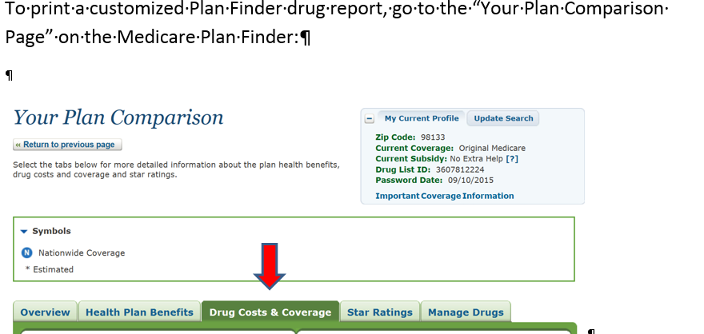
Printing/Sharing Results
See job aid on how to print/share a customized Plan Finder drug report- separate handout

Slide 30
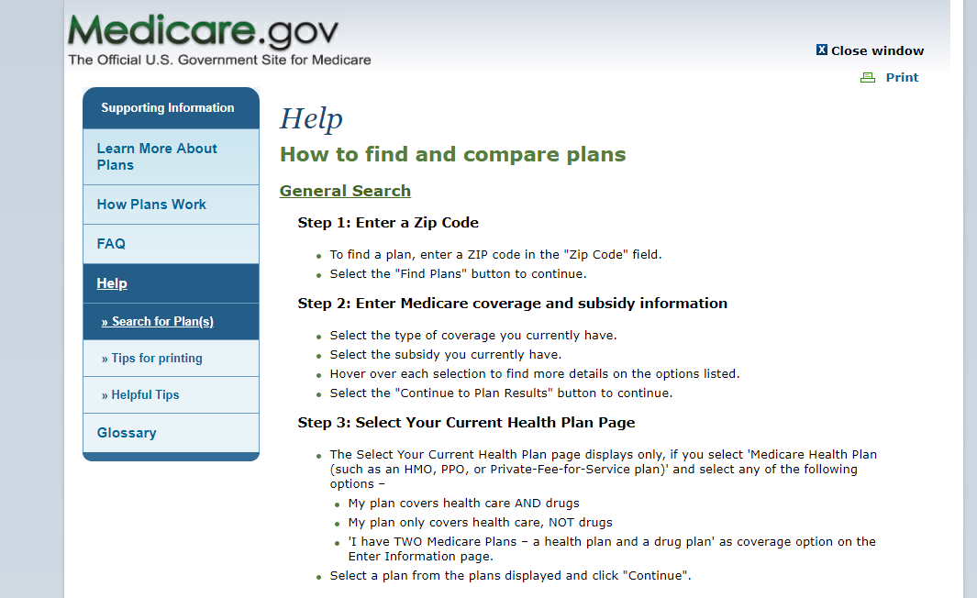
Help Tab
Notes:
Points to cover:
Step-by-step on how to do a “general” and “personalized” search
Note there is a link to FAQs-

Slide 31
Reporting MPF Issues
Please send any questions or issues to Liz Mercer LizM@oic.wa.gov 360-725-7225
Liz must report issues to ACL using a specific MPF Intake form
You MUST be able to give a lot of detail about what you are experiencing, such as exactly what you were doing in the MPF so we can re-create the problem for the tech people to review.
SHIBA will send out notifications to Volunteer Coordinators about known MPF issues. VC’s will need to distribute to their local volunteers.

Slide 32
Online Resources
CMS National Training Program Open Enrollment Toolkit https://cmsnationaltrainingprogram.cms.gov/ntp-courses?q=global-search&combine=Medicare+Open+Enrollment
Understanding Medicare Part C & D Enrollment Periods https://www.medicare.gov/Pubs/pdf/11219-Understanding-Medicare-Part-C-D.pdf
Plan Finder Multimedia (5 step-by-step videos on how to use the MPF) https://cmsnationaltrainingprogram.cms.gov/ntp-courses?q=global-search&combine=Medicare+Plan+Finder
My SHIBA https://www.insurance.wa.gov/my-shiba

